Slide 1
Energy Time Fairness: Balancing Fair Allocation of Energy and Time for GPU Workloads
Qianlin Liang, Walid A. Hanafy, Noman Bashir,
David Irwin, Prashant Shenoy
December 06, 2023

Slide 2
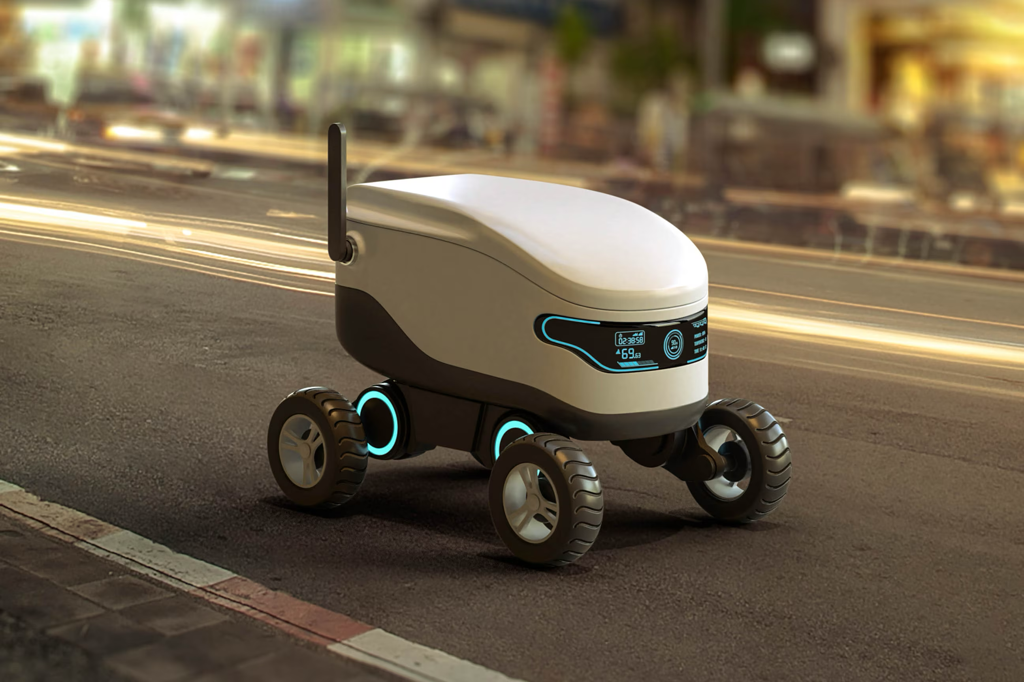
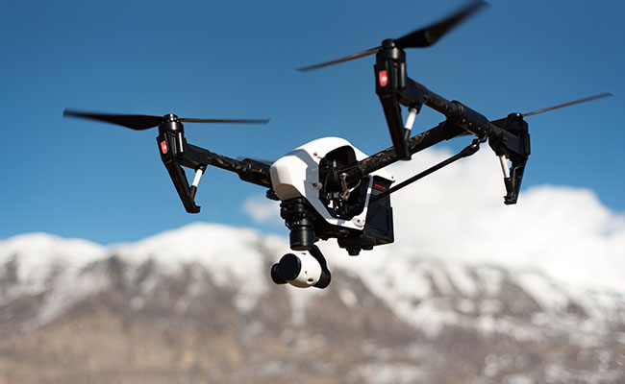
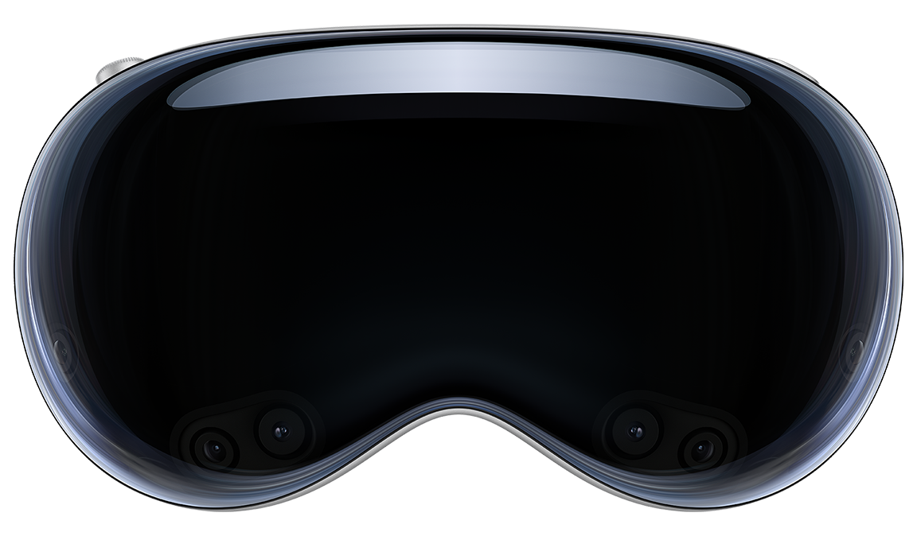
Multiplexing Resources At The Edge
Edge platforms multitasks, sharing computing and energy system.
Traditionally, resources are allocated through time fair-share scheduling.
Time fair-sharing overlooks energy, a scarce resource at the edge, leading to energy unfairness.
Manning College of Information & Computer Science
Notes:
- Proliferation of edge computing platforms has catalyzed the development of diverse edge applications, such as
- Time fair schedulers often result in disproportionate allocation of energy resources, leading to a significant discrepancy between the allocated time and energy shares.

Slide 3
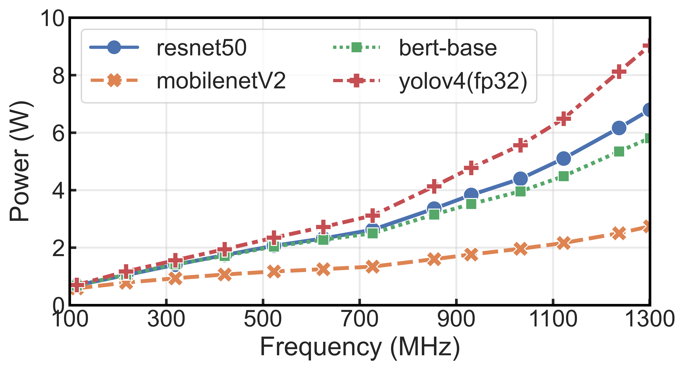
The Cause: Applications Power Disparity
DVFS in modern CPUs/GPUs allows applications running at varied frequencies, resulting in different power profiles.
Applications run on GPUs or multi-core processors can exhibit different power profiles, based on core utilization.
14x
4x
This power disparity leads to a divergence between time and energy fairness
Manning College of Information & Computer Science
Notes:
- key reason for this
- due to the applications of DVFS
- On the other hand, the advent of heterogeneous multi-core processors further rcomplicates this issue.
- Figure demonstrates this observation. Same model across frequencies. Same frequency across models.
- This power disparity leads to a divergence between time and energy fairness.

Slide 4
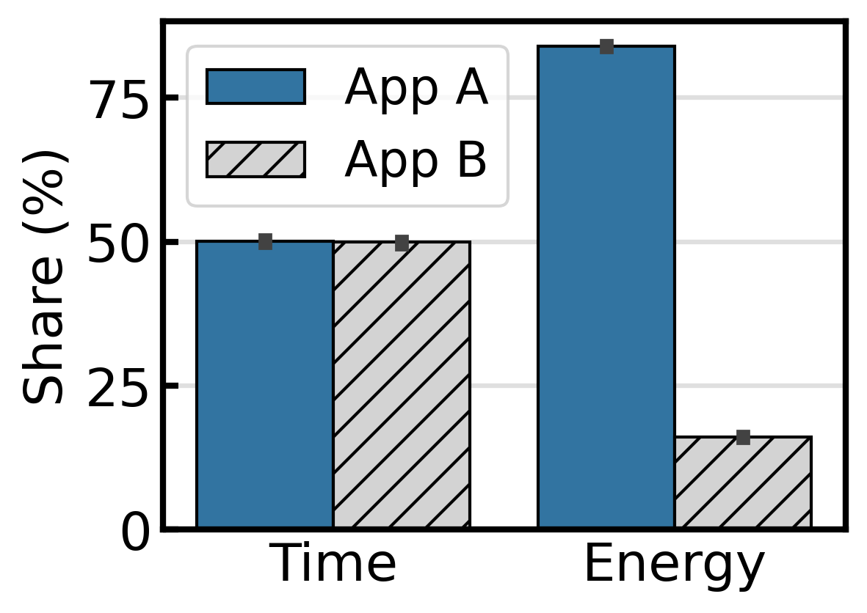
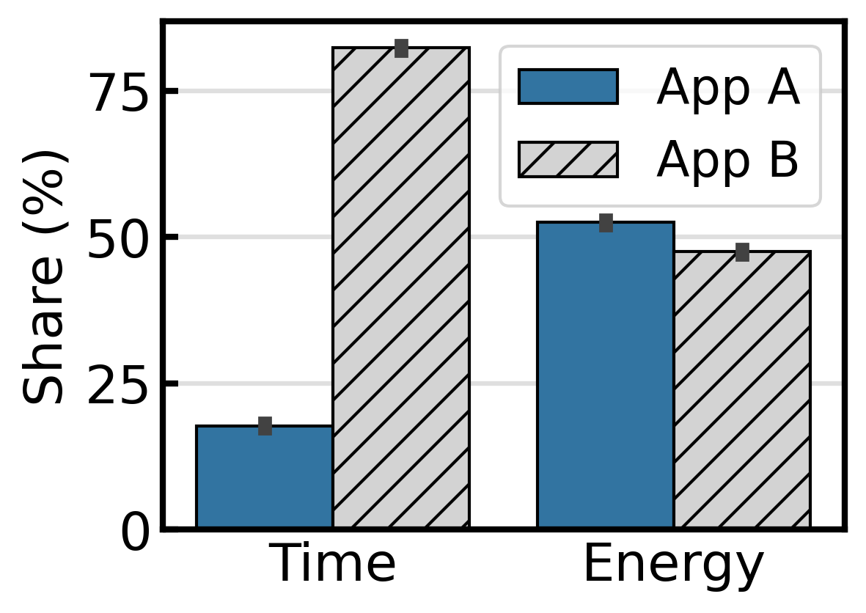
Divergence Between Time & Energy Fairness
In time fair-sharing, the system allocates larger shares of system energy to energy-hungry apps, leading to energy unfairness.
In energy fair-sharing, the system allocates more to energy-efficient apps to equalize energy use, resulting time unfairness.
Manning College of Information & Computer Science
Notes:
- time-base fair share scheduler
– energy fair share scheduler

Slide 5


Edge Implications of Time & Energy Fairness
Prevents premature battery depletion, ensuring service continuity.
Motivates users to improve their applications’ energy efficiency.
Ensures latency-sensitive applications to receive timely processing.
Maintains system throughput.
We aim to achieve optimal balance between time and energy fairness.
Manning College of Information & Computer Science
Notes:
But why we care about time and energy fairness?
It’s crucial for edge platforms to achieve optimal balance between time and energy fairness.
This is what we aim to achieve with our concept of energy time fairness or ETF.

Slide 6
Energy Time Fairness (ETF)
90
Enabling a configurable trade off between energy and time fairness.
80
70
60
50
SHARE (%)
40
Desired Properties
Pareto efficiency
Strategy proofness
Sharing incentives
30
20
10
0
TIME
ENERGY
App1
App2
Time Fair
Energy Fair
Manning College of Information & Computer Science
Notes:
Making it flexible

Slide 7
Energy Time Fairness
90
Enabling a configurable trade off between energy and time fairness.
80
70
60
50
SHARE (%)
40
Desired Properties
Pareto efficiency
Strategy proofness
Sharing incentives
30
20
10
0
TIME
ENERGY
App1
App2
Time Fair
Energy Fair
Manning College of Information & Computer Science
Notes:
Making it flexible

Slide 8


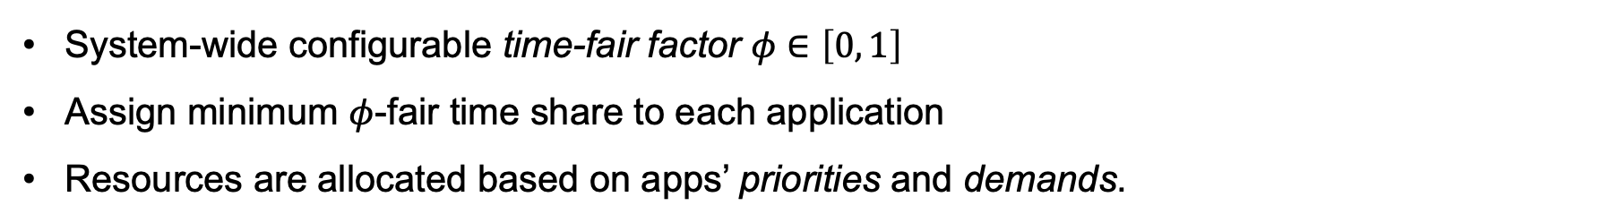
ETF Step 1: Guaranteeing Minimum Time Fairness
Unassigned time units $T$
Unassigned time units $(1−φ)⋅T$
16
60
14
50
12
40
10
Energy
Time
30
8
6
20
4
10
2
0
0
A
B
C
A
B
C
Applications
Applications
System-wide configurable time-fair factor $φ∈\left[0, 1\right]$
Assign minimum $φ$-fair time share to each application
Resources are allocated based on apps’ priorities and demands.
Manning College of Information & Computer Science
Notes:
$\phi$

Slide 9
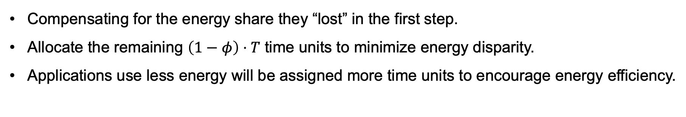
ETF Step 2: Prioritizing Energy Efficiency
Unassigned time units $(1−φ)⋅T$
16
60
14
50
12
40
10
Energy
Time
30
8
6
20
4
10
2
0
0
A
B
C
A
B
C
Applications
Applications
Compensating for the energy share they “lost” in the first step.
Allocate the remaining $\left(1−φ\right)⋅T$ time units to minimize energy disparity.
Applications use less energy will be assigned more time units to encourage energy efficiency.
Manning College of Information & Computer Science
Notes:
$\phi$
Talk about the properties. Prato efficiency, strategy proofness

Slide 10
System Implementation
Implemented as a GPU scheduler for model serving applications.
Open source at: github.com/umassos/energy-time-fairness
Manning College of Information & Computer Science
Notes:
- The ETF scheduler is a use-space scheduling library that abstract GPU and provide application-level interfaces
- The only different…
- Applications submit …
- Upon receive the kernel, the system…
- To accurately track time and energy usage… Profile
- To improve the efficiency…
- Open source

Slide 11
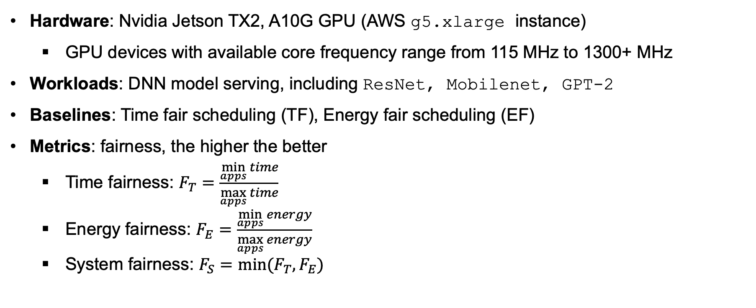
Evaluation Setup
Hardware: Nvidia Jetson TX2, A10G GPU (AWS g5.xlarge instance)
GPU devices with available core frequency range from 115 MHz to 1300+ MHz
Workloads: DNN model serving, including ResNet, Mobilenet, GPT-2
Baselines: Time fair scheduling (TF), Energy fair scheduling (EF)
Metrics: fairness, the higher the better
Time fairness: $F_{T}=\frac{\min_{apps}{time}}{\max_{apps}{time}}$
Energy fairness: $F_{E}=\frac{\min_{apps}{energy}}{\max_{apps}{energy}}$
System fairness: $F_{S}=min⁡(F_{T}, F_{E})$
Manning College of Information & Computer Science

Slide 12
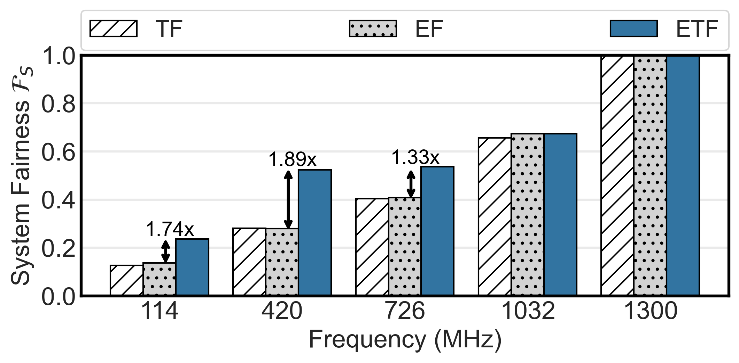
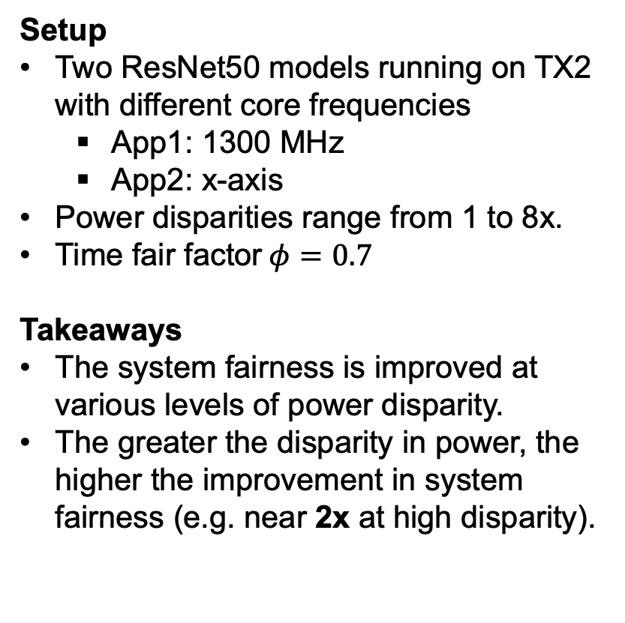
ETF bridges the gap between TF and EF
Setup
Two ResNet50 models running on TX2 with different core frequencies
App1: 1300 MHz
App2: x-axis
Power disparities range from 1 to 8x.
Time fair factor$φ=0.7$
Takeaways
The system fairness is improved at various levels of power disparity.
The greater the disparity in power, the higher the improvement in system fairness (e.g. near 2x at high disparity).
Manning College of Information & Computer Science

Slide 13
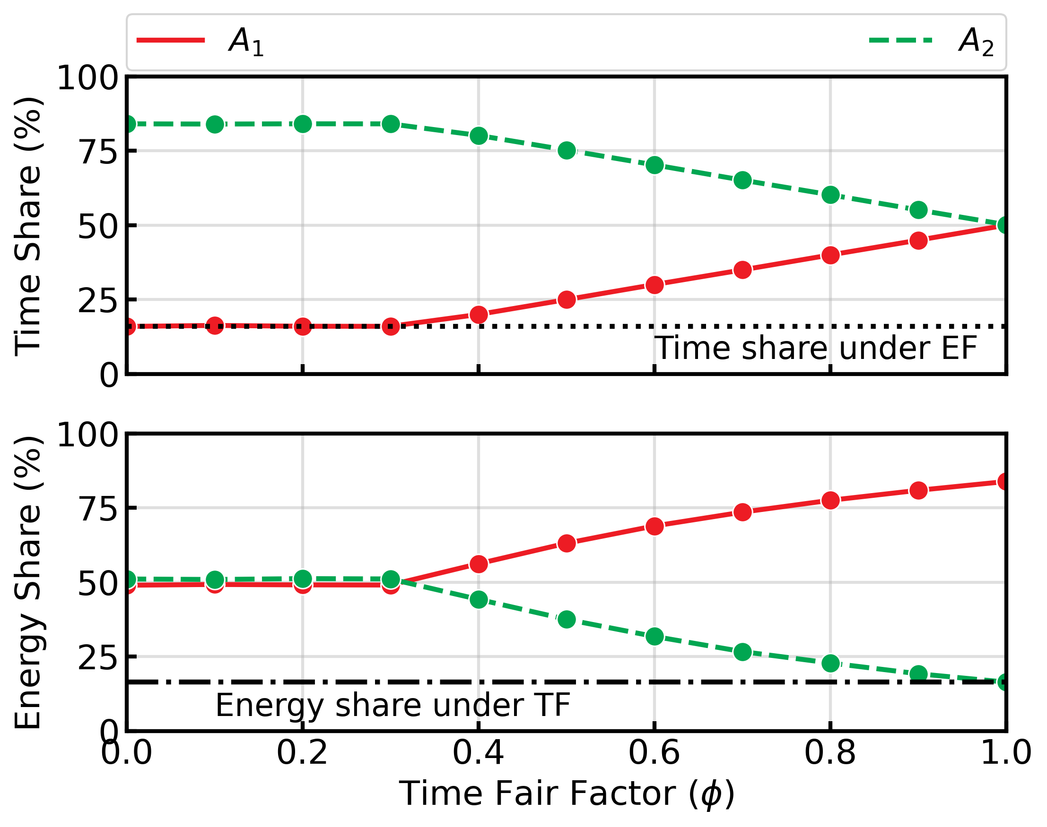
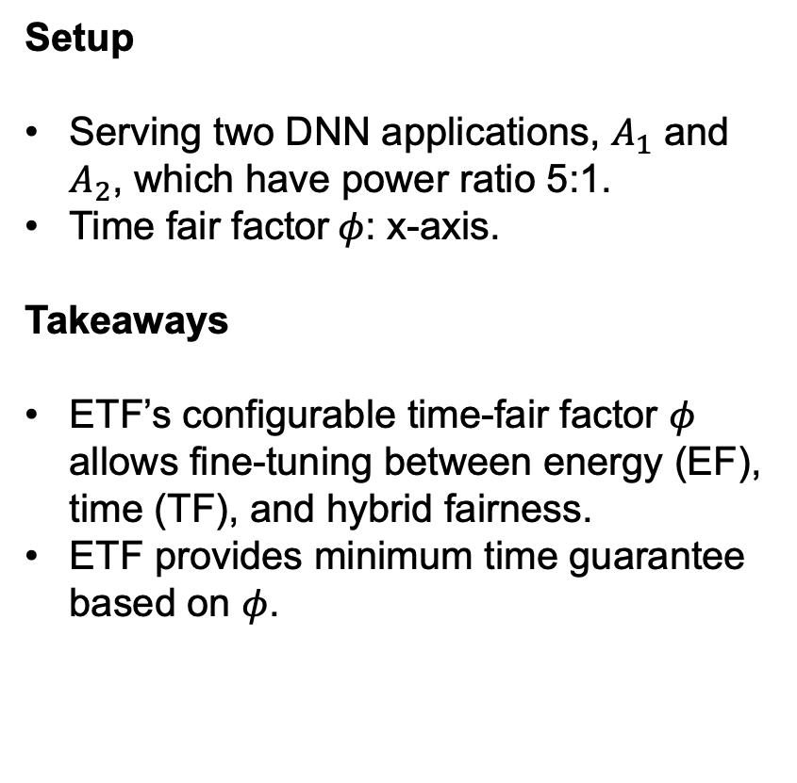
ETF improves energy fairness under time guarantee
Setup
Serving two DNN applications, $A_{1}$ and $A_{2}$, which have power ratio 5:1.
Time fair factor$φ$: x-axis.
Takeaways
ETF’s configurable time-fair factor $φ$ allows fine-tuning between energy (EF), time (TF), and hybrid fairness.
ETF provides minimum time guarantee based on $φ$.
Manning College of Information & Computer Science
Notes:
Phi = 1, perfect time fairness
Phi decreases, increase in energy fairness
After achieving perfect energy fairness, further decrease will have no effect

Slide 14
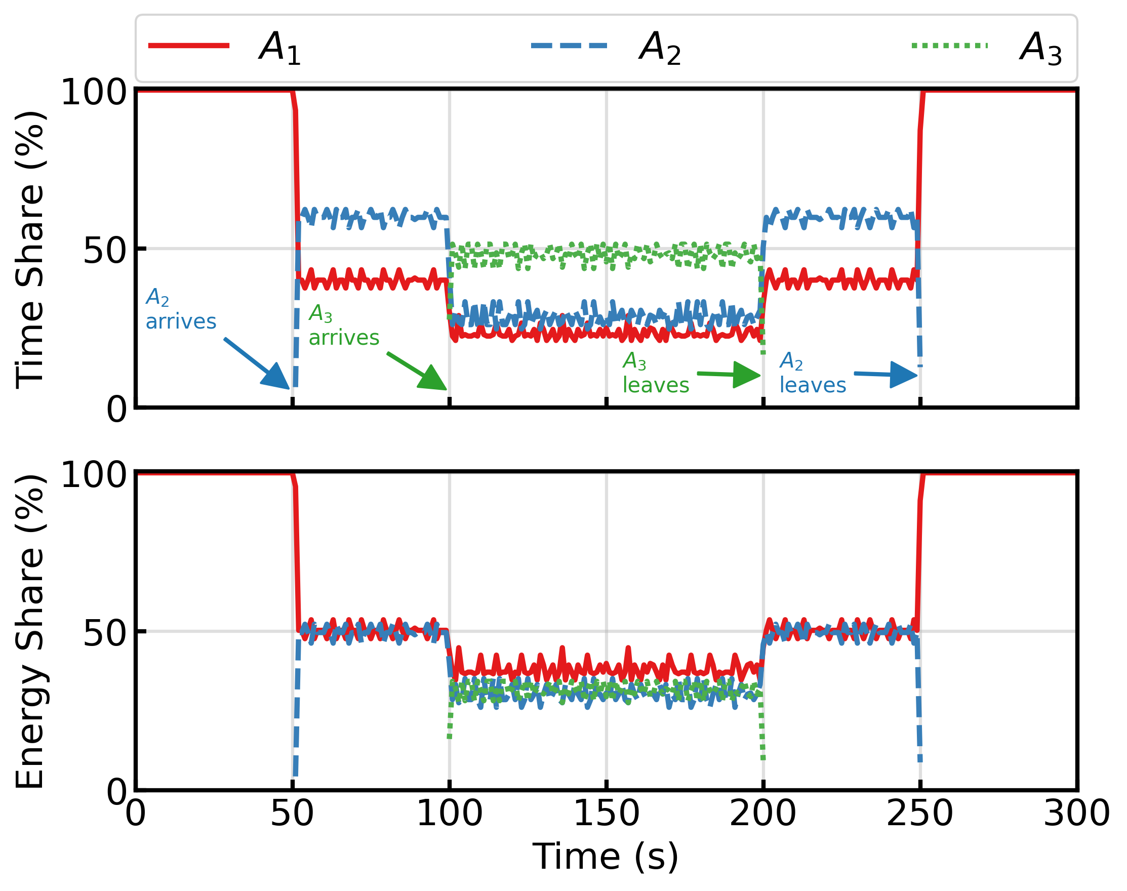
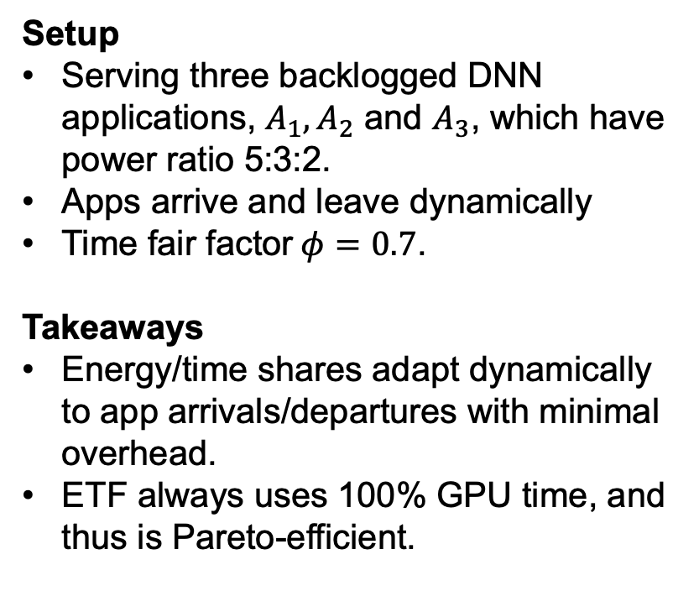
ETF handles dynamic workloads effectively
Setup
Serving three backlogged DNN applications, $A_{1}, A_{2}$ and $A_{3}$, which have power ratio 5:3:2.
Apps arrive and leave dynamically
Time fair factor$φ=0.7$.
Takeaways
Energy/time shares adapt dynamically to app arrivals/departures with minimal overhead.
ETF always uses 100% GPU time, and thus is Pareto-efficient.
Manning College of Information & Computer Science

Slide 15
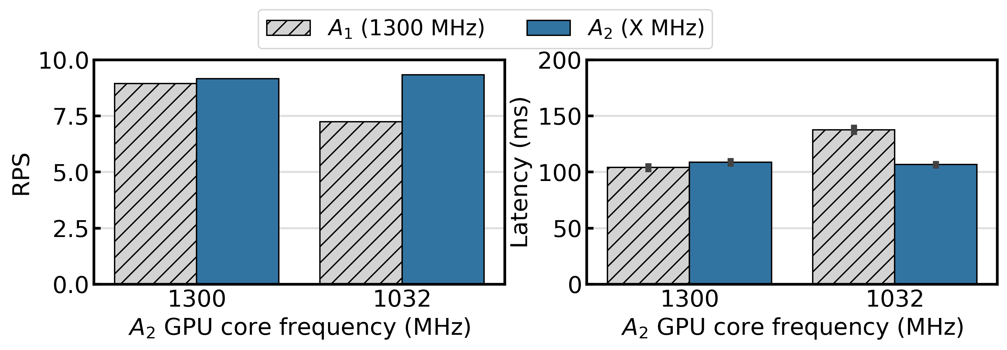
ETF incentivizes energy efficiency
Setup: Serving two same DNN applications at same and different GPU frequencies.
Takeaways: ETF rewards energy-efficient apps with a higher throughput and lower latency.
Manning College of Information & Computer Science
Notes:
This property of ETF holds the great potential for advancing sustainable computing practices, particularly in environments where energy efficiency is important.

Slide 16
Conclusion
Introduce Energy-Time Fairness (ETF): A novel approach for balancing energy and time allocation.
ETF aligns with desired fairness principles, effectively balancing energy and time fairness dimensions.
Our user-space GPU scheduler implementation of ETF ensures support for:
Time-sensitive applications.
Configurable incentive for energy-efficient operations.
Manning College of Information & Computer Science

Slide 17
Energy Time Fairness
90
Enabling a configurable trade off between energy and time fairness.
80
70
60
50
SHARE (%)
40
Desired Properties
Pareto efficiency
Strategy proofness
Sharing incentives
30
20
10
0
TIME
ENERGY
App1
App2
Time Fair
Energy Fair
Manning College of Information & Computer Science
Notes:
Making it flexible

Slide 18
ETF Step 2: Prioritizing Energy Efficiency
16
60
14
50
12
40
10
Energy
Time
30
8
6
20
4
10
2
0
0
A
B
C
A
B
C
Applications
Applications
System-wide configurable time-fair factor $φ∈\left[0, 1\right]$
Assign minimum $φ$-fair time share to each application
Adjust allocations so they don’t exceed individual demand.
Manning College of Information & Computer Science
Notes:
$\phi$

Slide 19
16
80
15
70
14
13
60
12
11
50
10
9
40
8
7
30
6
5
20
4
3
10
2
1
0
0
A
B
C
A
B
C

Slide 22
QUESTIONS & ANSWERS

