Slide 1

Towards Privacy-Preserving Audio Classification Systems
Bhawana Chhaglani, Jeremy Gummeson, Prashant Shenoy
Manning College of Information and Computer Sciences
HotEthics'24, April 28, 2024

Slide 2
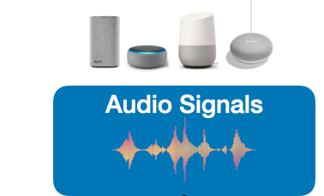

Audio contains privacy-invasive information
Audio data can reveal intimate details about a person.
Unauthorized access or misuse can have profound personal and social implications.
Speech: Sensitive conversations
Always
listening?
Speaker identity
Age
Gender
Health status
Mood and emotions
Background
Communication disorders
Notes:
Audio signals contains rich information. It can reveal intimate details about a person.
Like their conversations. And with audio sensing becoming more and more powerful, it can also infer speaker’s identity, age, gender, heath status, emotional status, background , communication disorders, etc
Today we are surrounded by listening devices, some of them are always on, some of are can be accidently triggered.
Thus, we need to think about privacy

Slide 3
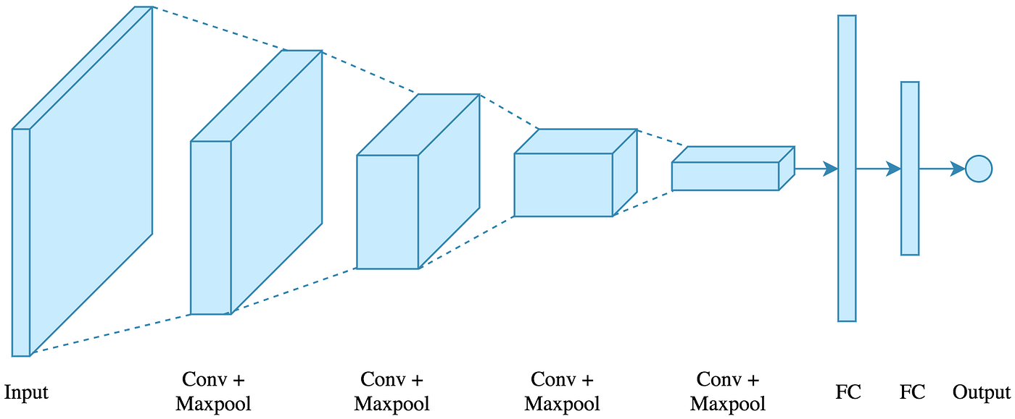
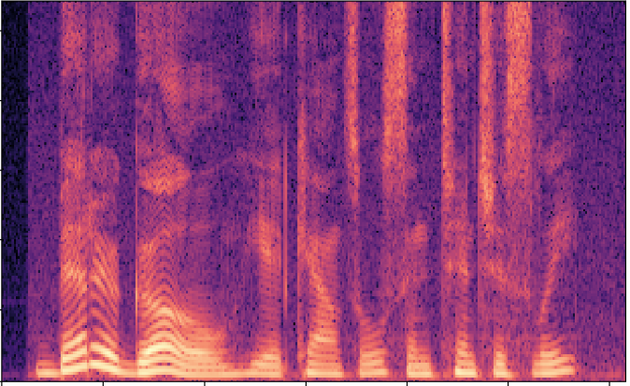
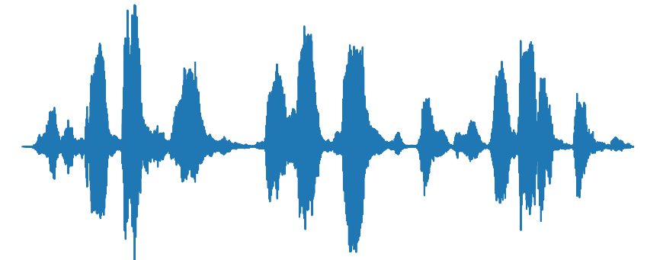
Typical Audio Classification Pipeline
Can be used to infer sensitive information
Prediction
Send to cloud
Audio wave
Spectrogram
DL model
Privacy remains one of the core problems in audio sensing systems
MFCC
Mel Spectrogram
STFT
Notes:
Existing audio classification pipeline convert audio to spectrogram feature representation like MFCC, mel spectrogram, STFT before feeding to DL model.
However, These features can compromise privacy. They can be used to infer variety of information. Like speech, speaker identity and whereabouts.
As DL models are computationally expensive, these spectrograms are sent to cloud which further heightens the privacy risk.

Slide 4
Privacy-Aware Audio Classification: Challenges
Expanding Privacy Beyond Speech
Existing approaches
- Filter speech segments [Xia 2020]
Obfuscate speech segments [Liaqat 2017]
Replace speech segments [Chen 2008]
Privacy varies with context
There is a need for a holistic definition of privacy.
[1] Xia, S., & Jiang, X. (2020, November). Pams: Improving privacy in audio-based mobile systems. In Proceedings of the 2nd International Workshop on Challenges in Artificial Intelligence and Machine Learning for Internet of Things (pp. 41-47).
[2] Liaqat, D., Nemati, E., Rahman, M., & Kuang, J. (2017, December). A method for preserving privacy during audio recordings by filtering speech. In 2017 IEEE Life Sciences Conference (LSC) (pp. 79-82). IEEE.
[3] Chen, F., Adcock, J., & Krishnagiri, S. (2008, October). Audio privacy: reducing speech intelligibility while preserving environmental sounds. In Proceedings of the 16th ACM international conference on Multimedia (pp. 733-736).
Notes:
There are several challenges when it comes to enabling privacy aware audio classification systems. The first one being:
Expanding Privacy Beyond Speech
Most prior works consider speech as the only privacy sensitive information in the audio signal.
Audio contains more privacy invasive information than just speech.
Privcay varies with context.Speech might be privacy invasive for some applications.
But maybe for other applications, gender/health are more invasive.

Slide 5
Privacy-Aware Audio Classification: Challenges
2. Complexity of Privacy Evaluation
Existing approaches
User study-based evaluation
[Parthasarathi 2012]
- Automatic Speech Recognition
[Chhaglani 2022]
WER does not indicate speaker related privacy leakage
There is a need for accurate and robust privacy evaluation mechanism.
[1] Parthasarathi, S. H. K., Bourlard, H., & Gatica-Perez, D. (2012). Wordless sounds: Robust speaker diarization using privacy-preserving audio representations. IEEE transactions on audio, speech, and language processing, 21(1), 85-98.
[2] Chhaglani, B., Zakaria, C., Lechowicz, A., Gummeson, J., & Shenoy, P. (2022). Flowsense: Monitoring airflow in building ventilation systems using audio sensing. Proceedings of the ACM on Interactive, Mobile, Wearable and Ubiquitous Technologies, 6(1), 1-26.
Notes:
Evalutaing privacy of an audio sensing system is non trivial.
Prior work uses user study based evaluation or ASR based evaluation. WER
User study based evlauations do not necerraily indicate speech privacy as advanced ASR systems can decode speech/phonemes even from filtered/featurized speech
As we discussed, privacy varies with context. It non-trivial to evaluate privacy. For example, WER does not measure the speaker related information leakage. WER might be high, but it could still compromise privacy.
robust privacy evaluation mechanism to measue privacy leakage of diff systems/ features
Privcay varies with context

Slide 6
Privacy-Aware Audio Classification: Challenges
3. Towards Universal Privacy Preservation
Existing approaches
- Design privacy sensitive features for a specific application:
Speaker change detection [Parthasarathi 2008]
Speech/Non speech detection [Parthasarathi 2011]
Requires manual effort in hand-crafting features
There is a need for generable privacy-aware features.
[1] Parthasarathi, S. H. K., Magimai.-Doss, M., Gatica-Perez, D., & Bourlard, H. (2009, November). Speaker change detection with privacy-preserving audio cues. In Proceedings of the 2009 international conference on Multimodal interfaces (pp. 343-346).
[2] Parthasarathi, S. H. K., Gatica-Perez, D., Bourlard, H., & Doss, M. M. (2011). Privacy-sensitive audio features for speech/nonspeech detection. IEEE transactions on audio, speech, and language processing, 19(8), 2538-2551.
Notes:
Requires manual effort to design hand-crafted features.

Slide 7
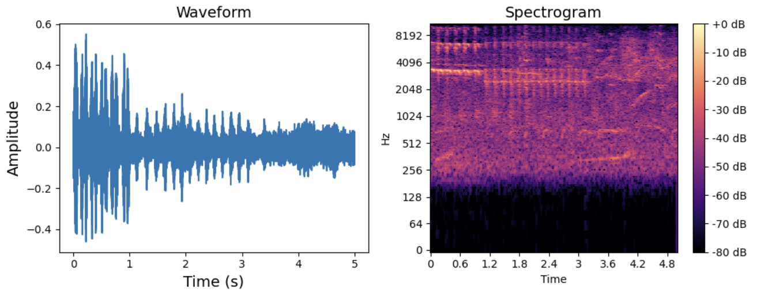
Our Approach: Generalizable Privacy-Preserving Audio Features
Goal: Privacy-preserving audio features that are universally applicable and maintain effectiveness of audio classification systems
Features Explored:
Time domain: energy, ZCR, RMS, peak value, etc.
Frequency domain: Spectral centroid, bandwidth, contrast, etc
Notes:
Work in progress with goal of goal
Rolloff, contrast, HNR, fundamental frequency

Slide 8
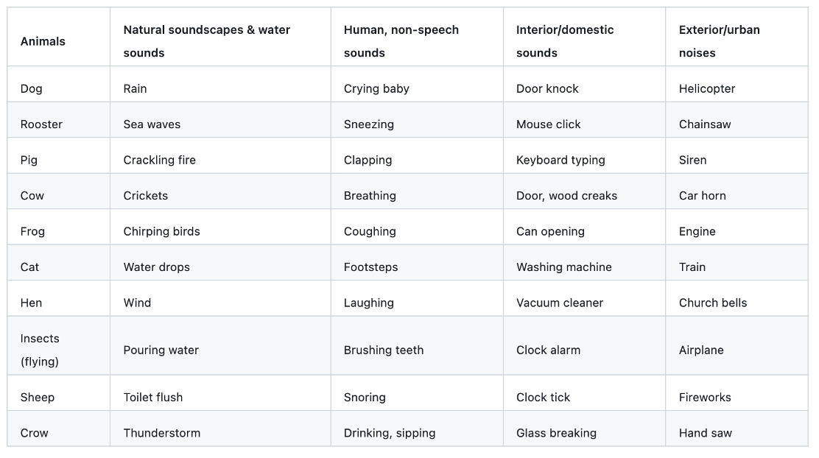
Preliminary Experiments with ESC-50
ESC-50 Dataset:
Dataset with 50 classes, fully annotated.
2000 audio files, each 5 sec long.
Preprocessing:
500ms chunks
Remove silent periods
Extract features
Notes:
Preprocessing Steps:
Process audio in 500 ms windows with an overlap of 10%
Remove silent periods
Feature Extraction

Slide 9
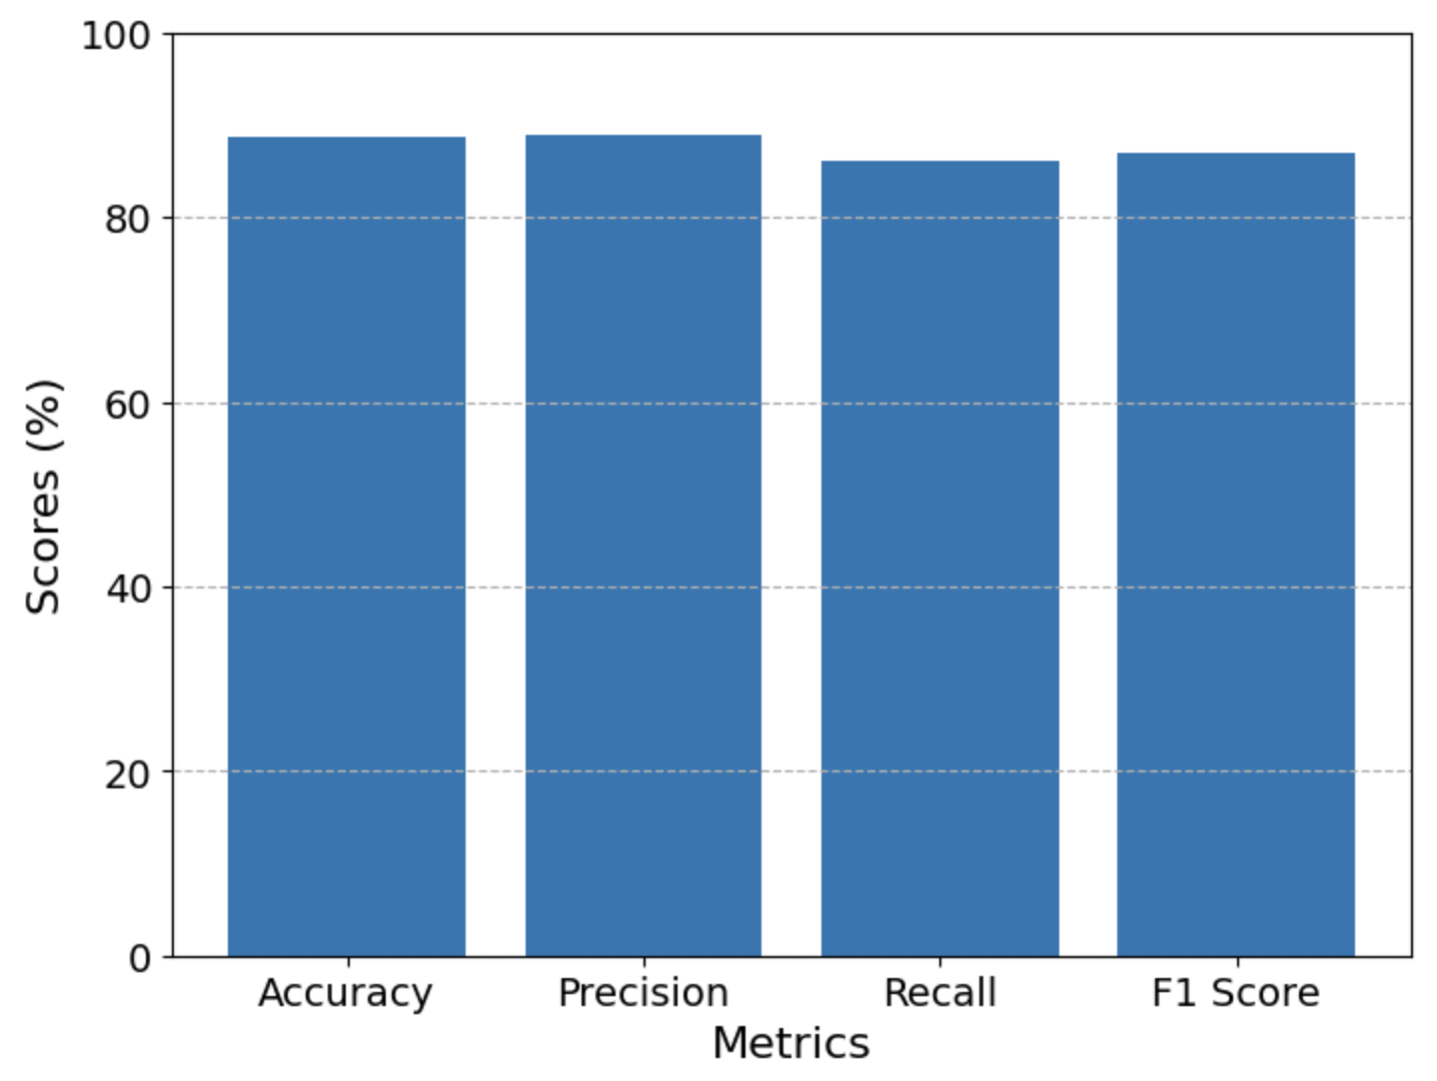
Results
80% train, 20% test
Random Forest Classifier
Average accuracy across classes: 92.23%
We can achieve comparable accuracy to prior work for wide range of classes using privacy preserving features
Feature Importance:
ZCR
HNR
Spectral contrast
Peak value
RMS

Slide 10
Conclusions and Future Work
Explored the privacy concerns in audio classification systems beyond just speech.
Identified the key challenges in enabling privacy-aware audio classification.
Proposed a set of generalizable privacy-preserving audio features.
Our vision is to extend the proposed privacy-preserving audio features to other audio sensing application: constraints and possibilities.
Contact me: bchhaglani@cs.umass.edu

