Slide 1
BreathEasy: Exploring the Potential of Acoustic Sensing for Healthy Indoor Environments
Bhawana CHHAGLANI, Camellia ZAKARIA, Jeremy GUMMESON, Prashant SHENOY
Manning College of Information and Computer Sciences ACM EnvSys 2023, June 18, 2023

Slide 2

Importance of Healthy Indoor Air
Humans spend more than 80% of their time indoors
Much work focuses on minimizing common air pollutants (e.g., dust, mold, VOC)
Gaining interest on human-expelled particles resulting in airborne disease transmission E.g., a person coughing produces more aerosol than a person speaking, increasing the risk of disease transmission

Slide 3
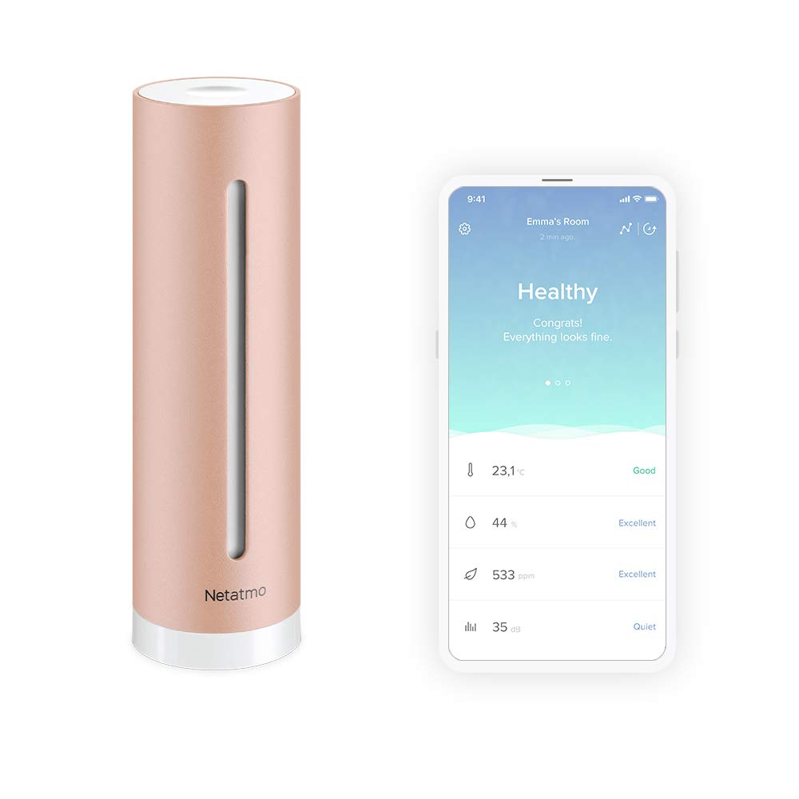
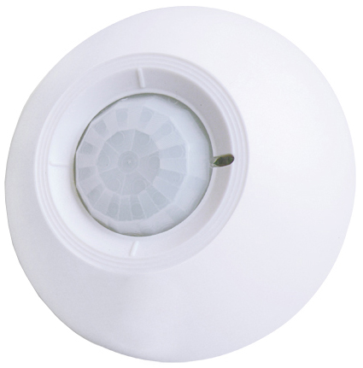
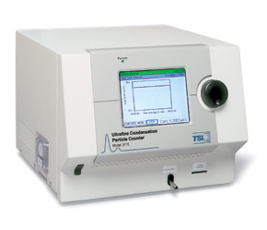
Current Research Landscape
Ventilation Sensing
CO₂ monitoring, occupancy detection to ensure optimum circulation within safe CO₂ threshold
No indication of human activities and amounts of aerosol produced
State-of-the-Art Aerosol Sensing Technology
Dedicated equipment that is inaccessible to normal users (bulky & expensive)
Typical usage in cleanroom, otherwise will sense a mix of particles in the air
Multiple key factors that influence airborne disease transmission indoors
Occupancy sensor, Indoor temperature, humidity and air quality sensor by Netatmo
Condensation Particle Counter

Slide 4
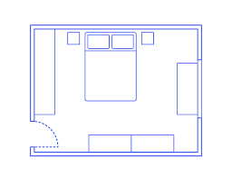
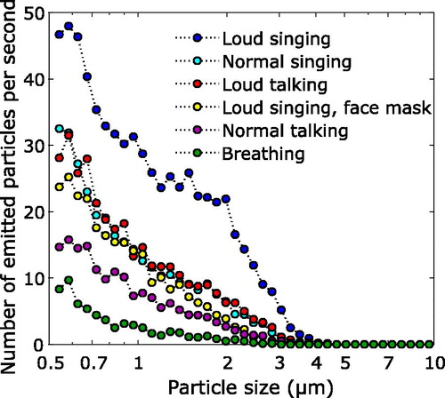

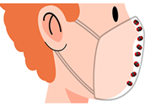
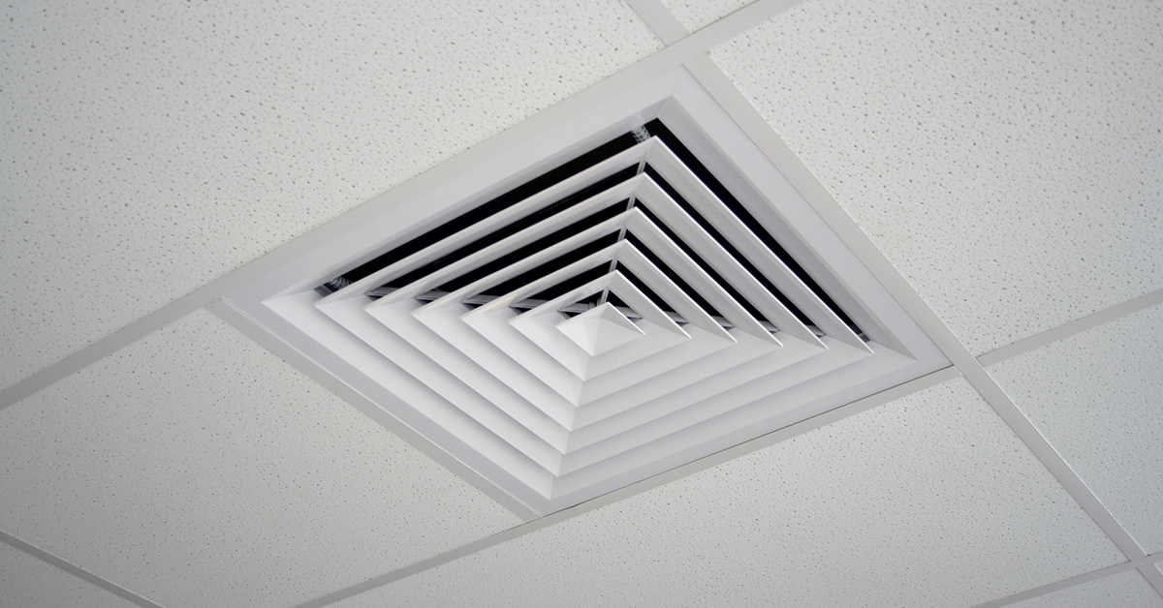
Risk Factors of Airborne Transmission
Human Activity Detection
1. Activity types
2. Activity loudness
Mask-wearing reduces particle emission by more than 70%.
Room size/layout
Occupant Distribution
Ventilation/Filtration
No. of Aerosol Produced
HUMAN FACTORS
ENVIRONMENT

Slide 5
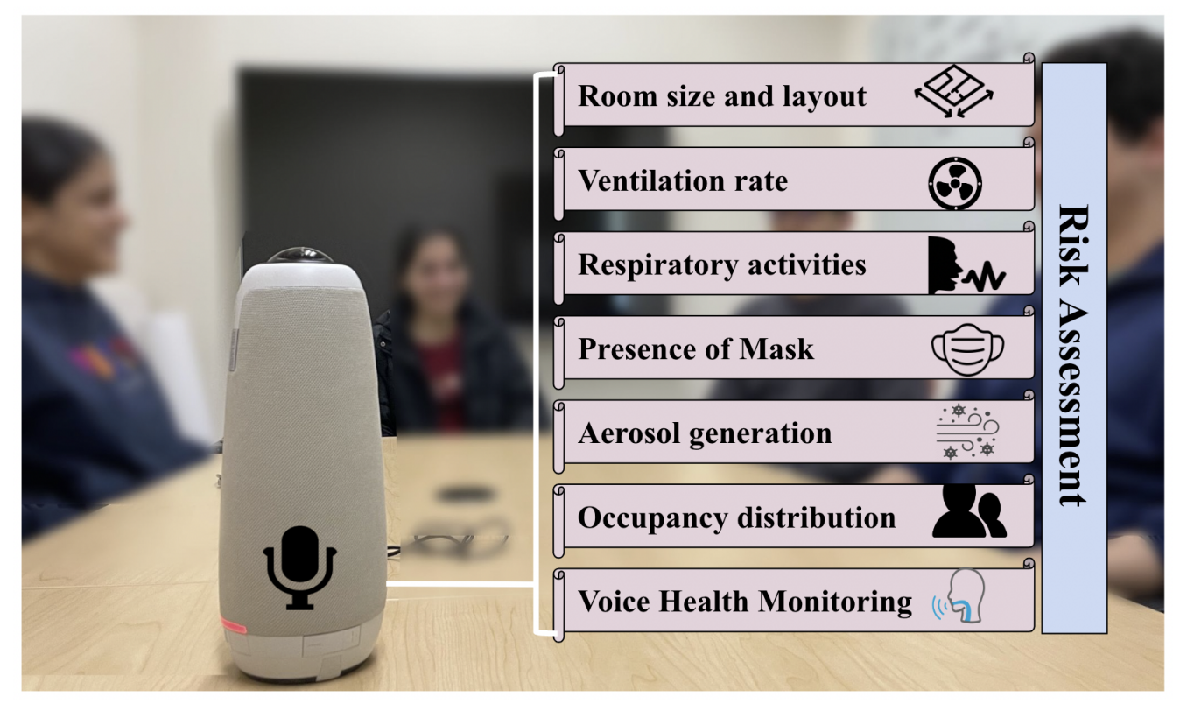
Envisioned System: BreathEasy
Ambient acoustic sensing to detect risk parameters of disease transmission indoors
Conceptual illustration

Slide 6
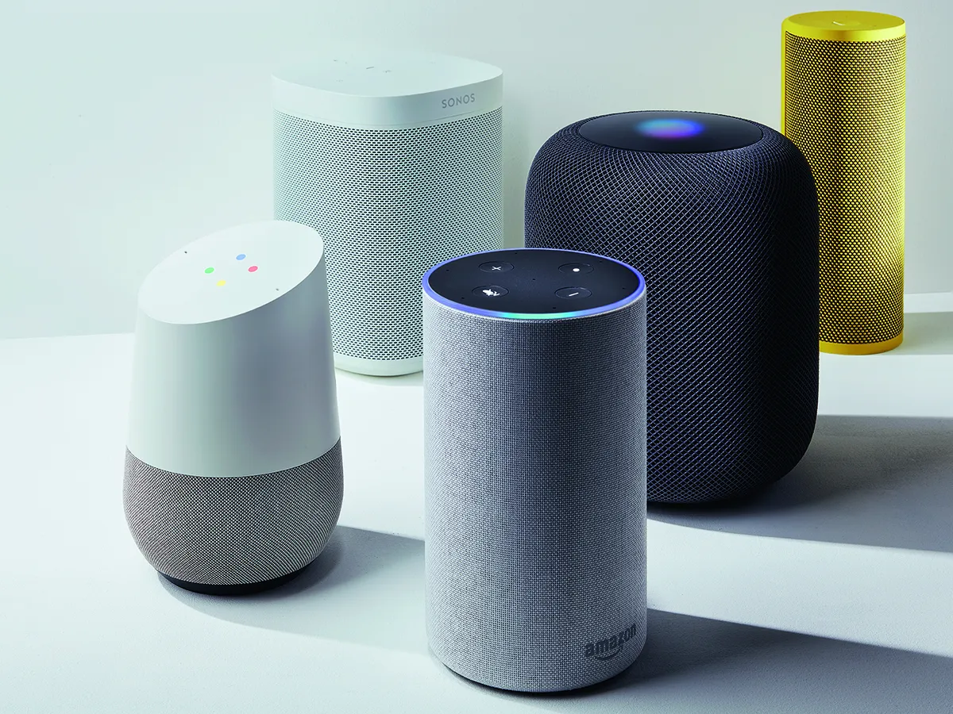
Audio Sensing as a Single Modality
Microphones are ubiquitous
Built-in smartphones
Smart speakers are increasingly present in households
Rich literature on audio sensing
Successful applications in activity detection
Voice health monitoring
Novelty in sensing indoor disease transmission risk parameters

Slide 7
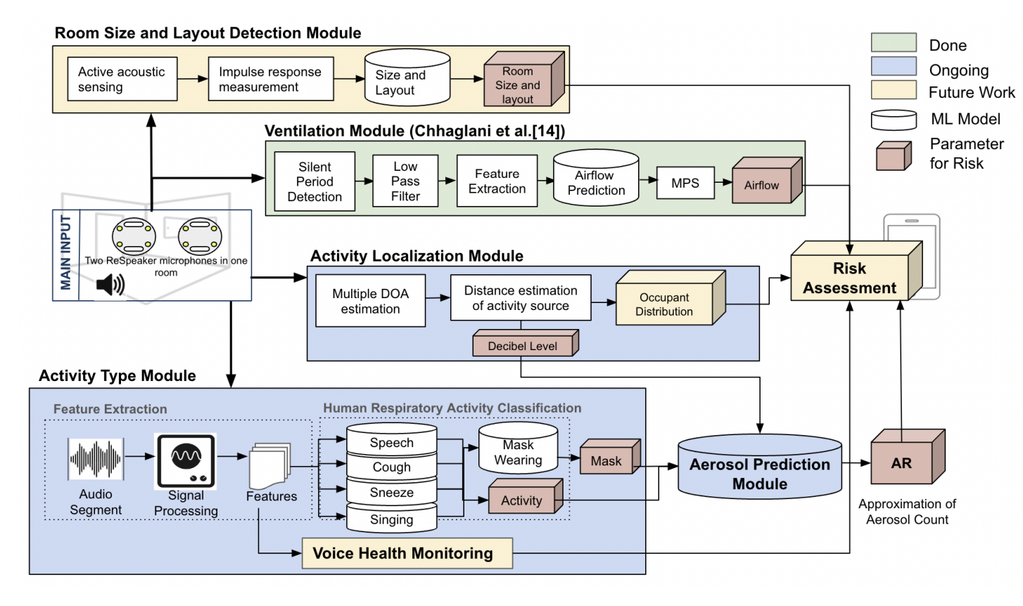
System Overview

Slide 8
Completed Component
FlowSense [IMWUT’22] senses the rate of air flow while preserving privacy
Samples audio signal during “non-speech” periods
Extracts feature from low-frequency signals
Reduce ambient noise interference through Minimum Persistent Sensing

Slide 9
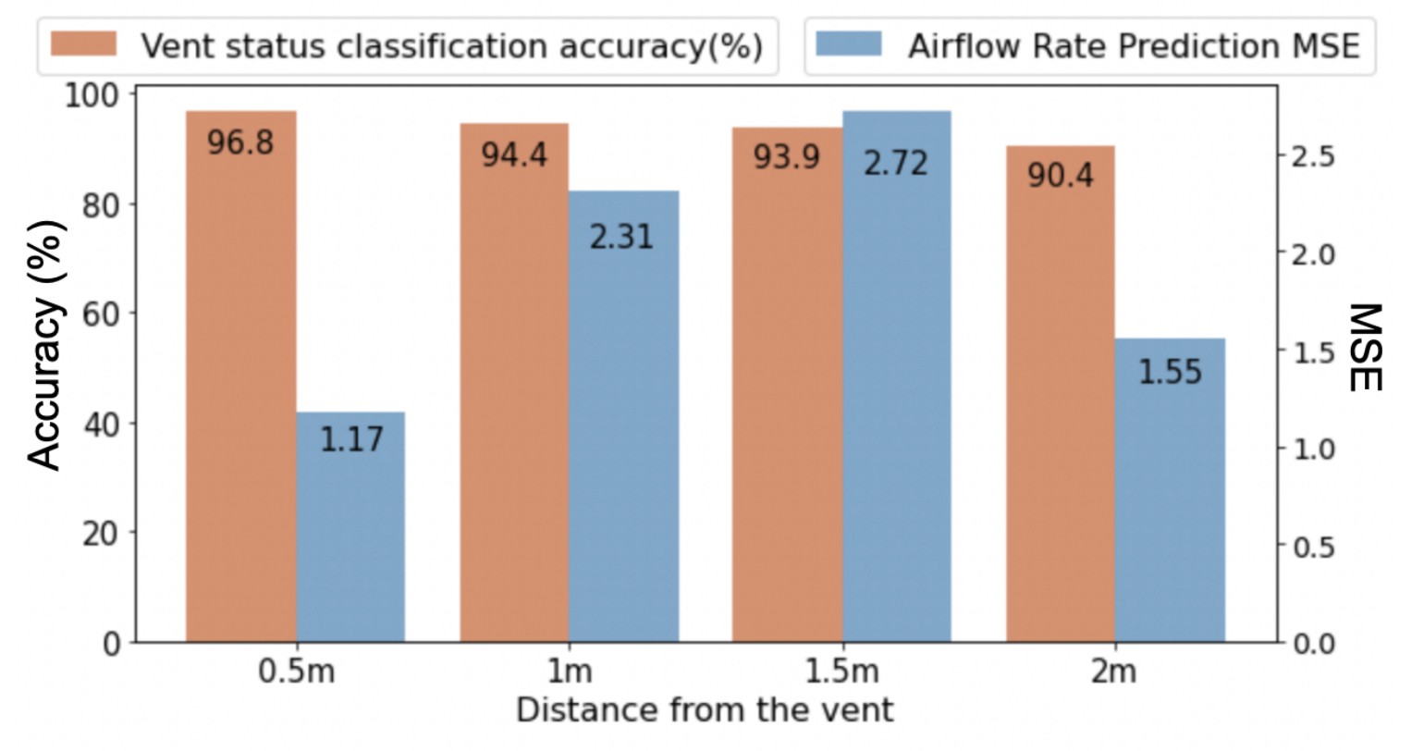
Sensing Rate of Air flow with FlowSense
Input: low-frequency audio features
Model 1: Gradient Boosting Classification Output: Vent status as on or off
Model 2: Gradient Boosting Regression Output: Rate of Air flow
Developed a mobile app, senses using built-in microphone
Collected air flow ground truth using Rev.p modern sensor
90% accuracy in detecting vent status when at least 2m away from the vent
MSE of airflow prediction varies between 1.17-2.72

Slide 10
On-going Development
AeroSense uses only non-reconstructible audio features to:
Detect activity types and loudness (e.g., talk, cough, sneeze → talking loudly vs. softly)
Determine mask-wearing during detected activity
Predict rate of aerosol produced from detected activity

Slide 11
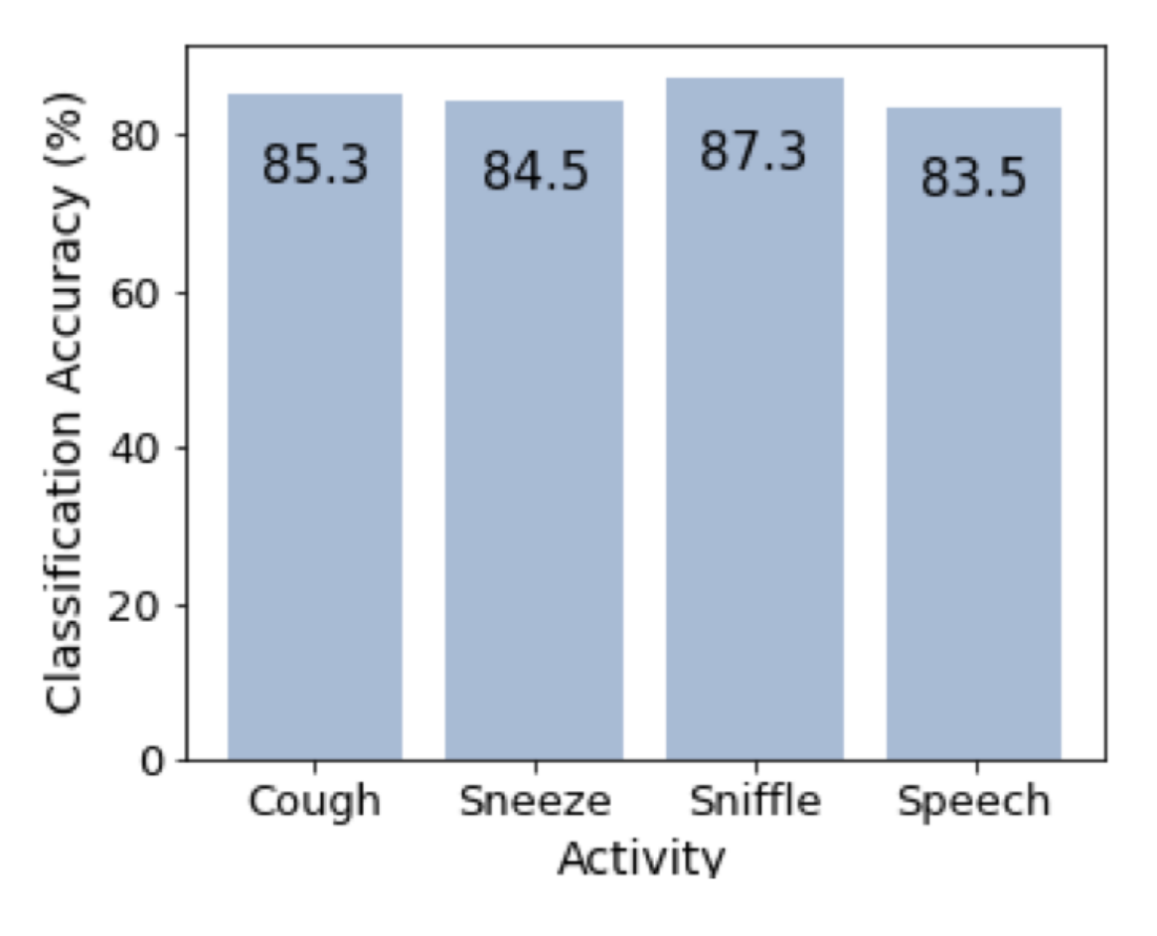
Detecting Activity Types with AeroSense
Input: Fixed set of non-reconstructible audio features
Models: Orchestration of activity binary classifiers Output: List of human respiratory-typed activities
Developed a Raspberry Pi prototype with omnidirectional microphone arrays
Collected aerosol expulsion from users as ground truth using Condensed Particle Counter in cleanroom
More than 80% accuracy in detecting various activities, simultaneously occurring

Slide 12
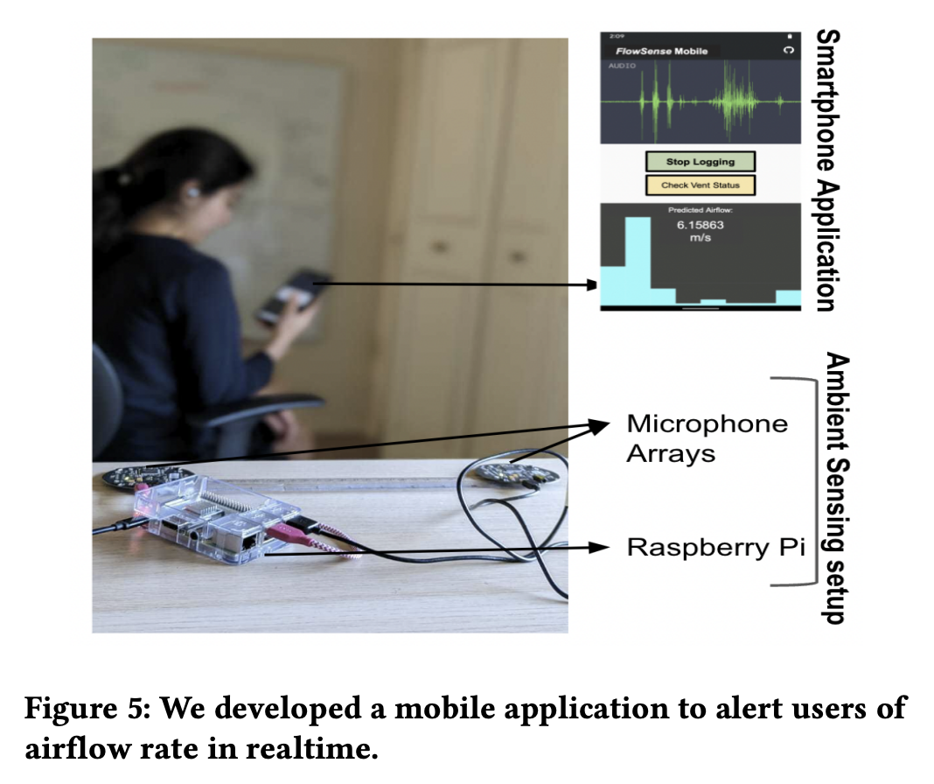
Key Takeaway and Future Work
√
Privacy-preserving audio sensing as a single modality
FlowSense to sense the rate of air flow
AeroSense to predict aerosol produced from human activities
Critical module extensions to realize BreathEasy
√
√
Room size and occupancy distribution detection
Challenge of tracking occupants with high mobility.
Voice health monitoring
Must support fine-grained and low-audio activities (e.g., breathing)
Risk assessment for airborne disease transmission must combine all component output.
Prototype Implementation
First Author: bchhaglani@cs.umass.edu

Slide 13
Research Challenges
Detection and Localization of simultaneous activities
Tracking the location and number of occupants in high mobility environment
Electronic sound Vs Human sound
Hardware heterogeneity across different microphones
Sensing low audio activities like breathing

Slide 14
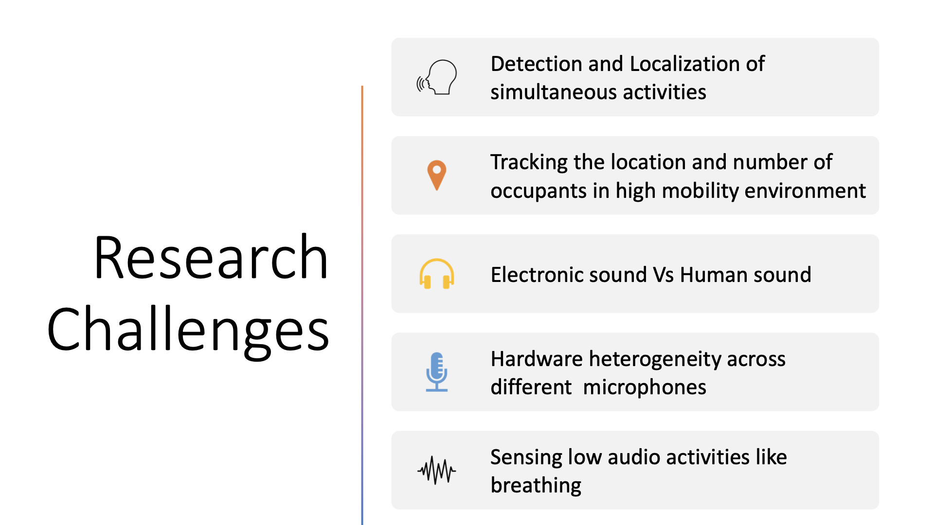
Research Challenges
Detection and Localization of simultaneous activities
Tracking the location and number of occupants in high mobility environment
Electronic sound Vs Human sound
Hardware heterogeneity across different microphones
Sensing low audio activities like breathing

Slide 15
Conclusions
This work investigates the possibility of developing BreathEasy, an acoustic-based sensing system to provide users with critical parameters informative of airborne transmission risks.
We discuss the design of subsystems necessary in realizing this vision.
We discuss the potential applications and research challenges of using acoustic sensing for healthy indoor spaces.
Contact me: shenoy@cs.umass.edu

