Slide 1

DeepSnow: Modeling the Impact of Snow on
Solar Generation
Noman Bashir, Prashant Shenoy, and David Irwin
University of Massachusetts, Amherst

Slide 2
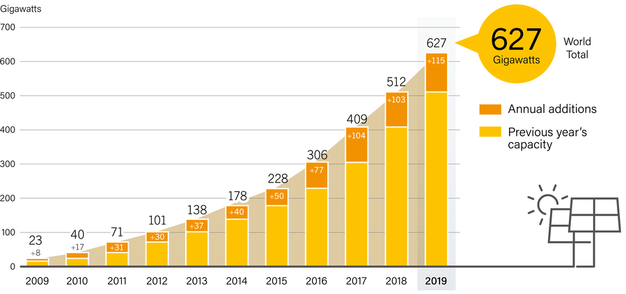
Solar is the future
Solar power is rapidly increasing
Up to 100MW solar PV added world-wide each day¹
On track to be the largest source of electricity by 2050
Other forms of energy cannot compete with solar
Cost decreasing at scale and with increase in efficiency
Low maintenance, fuel-less operation, and ease of installation
¹ source: www.iea.org, figure source: renewable global status report

Slide 3
Solar power is highly variable
High sensitivity to environmental conditions
Primarily affected by clouds, temperature, and snow.
How to mitigate the variability challenge?
Use storage to smooth out fluctuations
Still expensive, progress lags solar
Accurately model and predict solar output
Help plan energy supply, value solar sites for financing
Sunny - cold
Sunny - hot
Cloudy
Snow

Slide 4




Solar performance modeling is an active research area
Models estimate site’s current or future output
Based on site’s characteristics, i.e. tilt, and environment, i.e. cloud
Many models available, i.e. pvlib, SAM, Solar-TK
Models above are generally highly accurate
Work well under clear sky; decent under clouds
Accuracy degrades significantly under snow
System
Advisor
Model
(SAM)
Solar-TK

Slide 5
Modeling effect of snow is important
Some regions with high solar growth are snowy
Examples are Massachusetts and Germany
Variability in solar is disproportionately affected by snow
Short-term uncertainty complicates grid operation
Long-term inaccuracy impacts return-on-investment
8
Solar varies over years
Variability is due to snow

Slide 6
A simple model is not enough
Simple model:
if snow depth > x
output = 0
Prior work suggests
x to be 1-5cm
Snow effect is more complex than just snow depth

Slide 7
Factors affecting solar power under snow
Optical properties of snow determine power output
Snow depth is one of the factors affecting opaqueness
Dependent on flake size, density, water content, etc.
Public snow data is not same as snow on panel surface
Weather stations generally dozens of miles away
Data measured on flat ground, wood board, or grass
Solar panels are tilted and possibly under shadows

Slide 8
Rest of the talk
Snow data analysis
DeepSnow modeling approach
Implementation and evaluation

Slide 9
Snow effect is complex
Snow data from NOHSRC¹
40+ snow related variables; modeled or observed
Data cleaning: reporting %age and correlation
Factors too numerous and complex to physically model
Effect of individual variables can possibly be modeled
No physical model exists combining all variables
Snow depth (modeled) | Snow depth (observed) | Snow precipitation | Non-snow precipitation
Dew-point temperature | Air temperature | Wind speed | Humidity
¹National Operational Hydrologic Remote Sensing Center

Slide 10
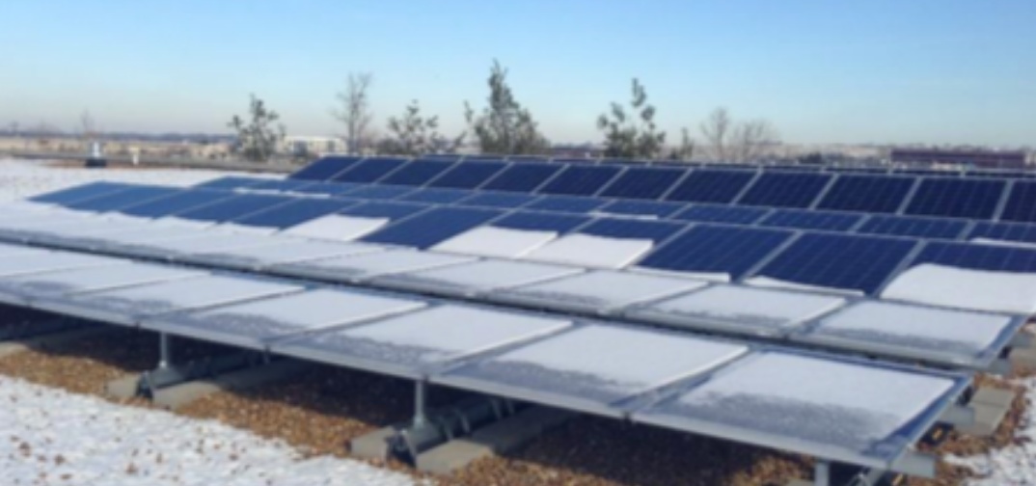
Snow data on panel surface is more complex
Site characteristics impact actual snow on panel
Sliding because of panel tilt and low surface friction
Low melting rate under shadow from nearby objects

Slide 11
High tilt leads to more snow slide
higher tilt → high power output
*Sites ordered by increasing tilt ranging from 15° to 60°

Slide 12
Shading prevents snow from melting
Shaded sites generate less energy
*Sites in each group are within 1 mile of each other on a snowy day

Slide 13
Snow complexity suits deep learning
Framing deep learning approach is non-trivial
Decouple the effect of snow from other variables, i.e. cloud
Leverage existing work on solar performance modeling
Snow data
Tilt, orientation
Snow loss factor
(SAM)
Shading factor
(Solar-TK)
DeepSnow
Model Trainer
DeepSnow
parameters
Solar performance model output w/o snow effect
DeepSnow Model snow adjustment factor
Range: 0 -1
snow-adjusted
generation
optional features
required
output

Slide 14

Evaluation setup
Dataset: hourly data for actual solar sites
10 solar sites across CO, IL, MA, MN, and NY
Site capacities in 1kW to 50kW range
Evaluation Metric: Short- and long-term accuracy
Short- and long-term: instant. power and annual energy
Mean Absolute Percentage Error (MAPE)
$MAPE= \frac{100}{T}\sum_{t=0}^{T}{\left|\frac{ground truth−forecast}{ground truth}\right|}$
Lower MAPE means high accuracy
Baseline: Solar-TK and SAM
No snow model in Solar-TK
SAM models slide based on temp. and tilt

Slide 15
Evaluation: annual energy estimate
~50% reduction
in MAPE
~9% reduction
in MAPE
DeepSnow performs outperforms SAM for all sites

Slide 16
Evaluation: power output estimate
DeepSnow outperforms SAM for all sites

Slide 17
Evaluation: power output estimate in winter
~54% reduction
in MAPE
~95% reduction
in MAPE
Winter improvement is much more significant

Slide 18
Conclusion
Modeling effect of snow on solar is important
Snow effect is complex and cannot be physically modeled
DeepSnow leverages deep learning
Using publicly available snow data
Leverages prior work on solar modeling
DeepSnow outperforms state-of-the-art models

Slide 19
Open to questions
Contributions
Modeling the effect of snow on solar output is important
At places with snow, it is the major cause of variability
Modeling the effect of snow is challenging
We improve state of the art

