Slide 1


SLO-Power: SLO and Power-aware Elastic Scaling for Web Services
Mehmet Savasci¹, Abel Souza¹, Li Wu¹, David Irwin¹, Ahmed Ali-Eldin², Prashant Shenoy¹
¹University of Massachusetts Amherst, USA
²Chalmers University of Technology, Sweden
The 24th IEEE/ACM International Symposium on Cluster, Cloud and Internet Computing | Philadelphia | May 6-9, 2024

Slide 2
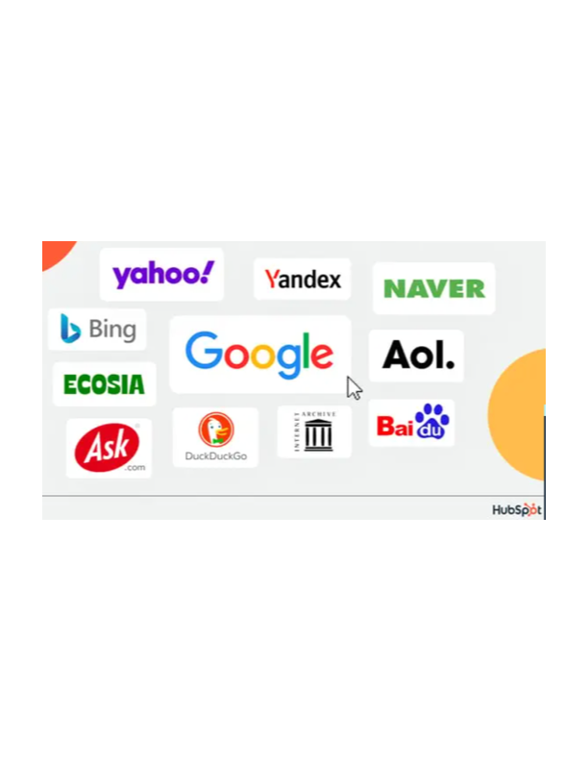





Era of Latency-Sensitive Web Services
Billions of users interact with latency-sensitive web services everyday.
Social media, media streaming, search engines, online shopping, etc.
These applications typically run on cloud data centers.
Notes:
time limit for how long something can take. E.g. pizza delivery is latency sensitive because the pizza will be cold if it takes longer than 15 minutes to be delivered (and "15 minutes" is not "fast" or "immediate")
https://www.positivelyosceola.com/streaming-services-laying-out-some-good-deals-while-were-socially-distancing/
59% of the world's population uses social media. The average daily usage is 2 hours and 31 minutes
There are 2.14 billion online shoppers in the world
Approximately 3 billion people worldwide play video games
The number of subscriptions to online video streaming services worldwide reached 1.1 billion in 2020, according to data by the Motion Picture Association.
Typically, they run on cloud or private datacenters.

Slide 3
Growth of Datacenter Market
The growth of web services has boosted cloud platforms, thus, global data center market.
Cloud Computing Market Size (Credit: Precedence Research)
Outcome: Today’s datacenters consume 3% of the world’s electricity.
Notes:
Mention effect on growth on power grids. That is, power grids have difficulty in providing necessary power to datacenters. Northern Virginia host the largest concentration of data centers in the world.
The industry uses over 12% of Dominion Energy Virginia’s total electricity supply, more than any other business category.
As of 2021 it is equivalent to about 1.6 million homes.
Projections indicate that the local power grid will be unable to keep up with energy demands. Although cleaner technologies are available, the vast majority of these generators burn diesel fuel, releasing pollutants that pose risks to human and environmental health.
The energy shortfall has been anticipated since last year, when Dominion Energy first said it had not upgraded electric transmission infrastructure fast enough to keep up with the rapid growth of data centers.
https://arxiv.org/pdf/2311.11645 → Exploding AI Power Use: an Opportunity to Rethink Grid Planning and Management

Slide 4
Workload Pattern of Online Web Services
Online web services see dynamic workloads.
Elastic scaling for handling dynamicity in web workloads.
Scale-up or scale-down resources accordingly.
Elastic scaling methods are, in general, designed to overprovision resources.
Notes:
Web services see dynamic workloads. Even though most of times the workload dynamic is low, there are time we see peak workloads.
They are provisioned for peak workloads
47% of users won’t wait longer than two seconds for a website to load A website’s loading speed has a significant impact on user experience and satisfaction. According to recent data, nearly half of users won’t wait longer than two seconds for a website to load.[10] This puts pressure on website owners to ensure their pages load quickly, or risk losing potential visitors. With the increasing usage of mobile devices, fast load speeds are becoming increasingly important as well. 15. 40% of users will leave a site if take more than three seconds to load
https://aws.amazon.com/blogs/database/running-spiky-workloads-and-optimizing-costs-by-more-than-90-using-amazon-dynamodb-on-demand-capacity-mode/

Slide 5

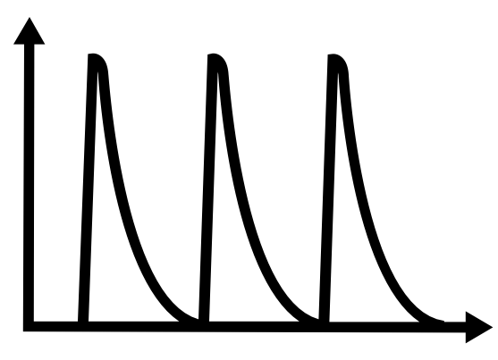
Resource Overprovisioning
Elastic scalers tend to allocate more resources than required.
Main reason:
Meeting SLO requirements by even handling the peak workload.
SLO
Elastic scalers are SLO-aware but power-unaware.

Slide 6
Managing Power Consumption of Datacenters
Managing the power consumption of cloud workloads is a must.
Various mechanisms for managing power consumption are:
RAPL
DVFS
Forced idleness
Power capping techniques can hurt application performance. They are also SLO-unaware.

Slide 7
Summary
Using either elastic scaling or power management alone can only achieve one goal: meeting SLOs or saving power.

Slide 8
Problem Statement
How to jointly use resource scaling and power allocation for web services to optimize resource and power efficiency while fulfilling their SLO?

Slide 9
Talk Outline
Motivation & Problem Statement
System Design
Evaluation
Conclusion
Notes:
time limit for how long something can take. E.g. pizza delivery is latency sensitive because the pizza will be cold if it takes longer than 15 minutes to be delivered (and "15 minutes" is not "fast" or "immediate")
https://www.positivelyosceola.com/streaming-services-laying-out-some-good-deals-while-were-socially-distancing/
59% of the world's population uses social media. The average daily usage is 2 hours and 31 minutes
There are 2.14 billion online shoppers in the world
Approximately 3 billion people worldwide play video games
The number of subscriptions to online video streaming services worldwide reached 1.1 billion in 2020, according to data by the Motion Picture Association.
Typically, they run on cloud or private datacenters.

Slide 10
Our Approach: SLO-Power
Incorporates elastic scaling and power management techniques
Comprises three components
SLO-Power Controller (light gray), Elastic scaler (blue), Power allocator (green)
Elastic scaler is closer to load balancer and makes decisions based on incoming traffic
Power Allocator is closer to application and runs under Elastic Scaler

Slide 11


Joint Elastic Scaling and Power Allocation
Elastic scaler decides the number of cores to achieve target tail latency.
Modelled as M/G/c/PS system
Integrated reactive and proactive approaches.
Power allocator adjust the allocated power.
SLO-Power Controller decides when to trigger the elastic scaler or power allocation.
, where c: number of cores, T: target tail latency, 𝝺: arrival rate, 𝝁: service rate

Slide 12
SLO-Power Implementation
Centralized manager-agent architecture
Built upon Linux Containers (LXC)
SLO Agent actuators
RAPL for power allocation
cgroup for elastic scaler
https://github.com/umassos/SLO-Power
Notes:
Let me make all them are shorter

Slide 13
Talk Outline
Motivation & Problem Statement
System Design
Evaluation
Conclusion
Notes:
time limit for how long something can take. E.g. pizza delivery is latency sensitive because the pizza will be cold if it takes longer than 15 minutes to be delivered (and "15 minutes" is not "fast" or "immediate")
https://www.positivelyosceola.com/streaming-services-laying-out-some-good-deals-while-were-socially-distancing/
59% of the world's population uses social media. The average daily usage is 2 hours and 31 minutes
There are 2.14 billion online shoppers in the world
Approximately 3 billion people worldwide play video games
The number of subscriptions to online video streaming services worldwide reached 1.1 billion in 2020, according to data by the Motion Picture Association.
Typically, they run on cloud or private datacenters.

Slide 14
Experimental Setup
Cluster of machines (running Ubuntu 20.04, kernel: 5.4) connected with Gigabit ethernet
Hardware
Dell PowerEdge R440 (RAPL supported Intel Xeon Silver CPU)
Hyperthreading and turbo boost disabled
Application
MediaWiki (traditional LAMP stack software hosting a replica of Wikipedia)
HAProxy used as a load balancer (round robin)
Workload
Open-loop workload generator
Real workload traces: Wikipedia and Azure
Wikipedia
Azure

Slide 15
Evaluation -- Component Analysis
SLO violations
No SLO violations
No SLO violations
the lower better
High resource efficiency
Low resource efficiency
High resource efficiency
the higher better
High Power Optimality
Low Power Optimality
High Power Optimality
Power component
+
Elastic component
=
SLO-Power
Takeaway: Utilizing mechanisms jointly provides power optimality and resource efficiency while meeting SLO targets.
Notes:
Average core allocation:
Power component: 48
Elastic components: 34.5
SLO-Power: 35.2
Power optimality average:
power-component: 0.93
Elastic component: 0.7
SLO-Power: 0.87

Slide 16
Evaluation -- Baseline Comparisons
SLO-Power
Takeaway: SLO-Power achieves more controllable SLO-violation-free performance while reducing resource usage by 12%.

Slide 17
Conclusion and Future Work
SLO-Power jointly uses elastic scaling and power capping.
It optimizes power and resource efficiency and avoids SLO violations.
It attains controllable tail latency, while utilizing 12% fewer resources.
It is open source.
Future work: Diagonal scaling.
Notes:
Put Github link

Slide 18


SLO-Power: SLO and Power-aware Elastic Scaling for Web Services
Mehmet Savasci msavasci@cs.umass.edu Questions?

Slide 19
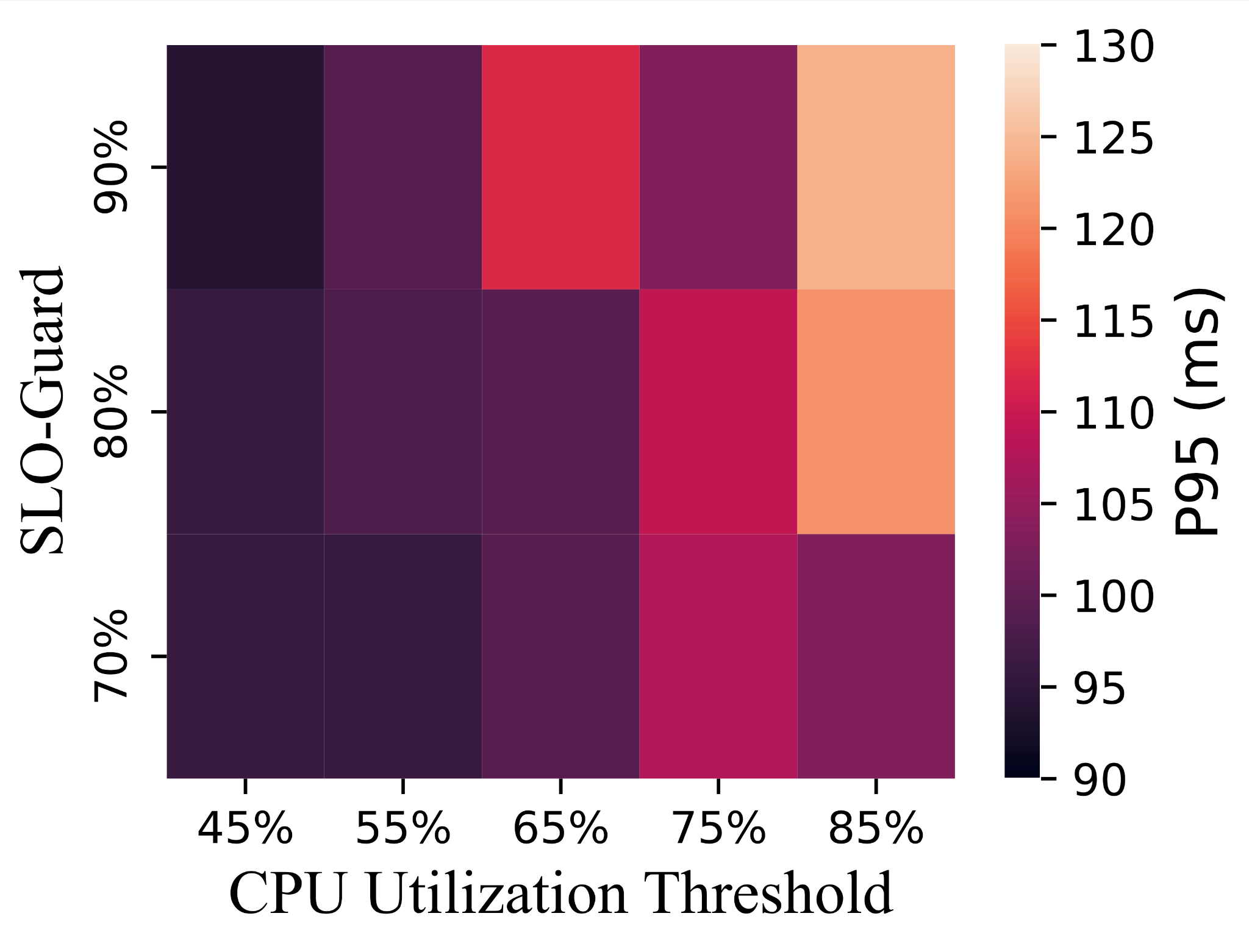
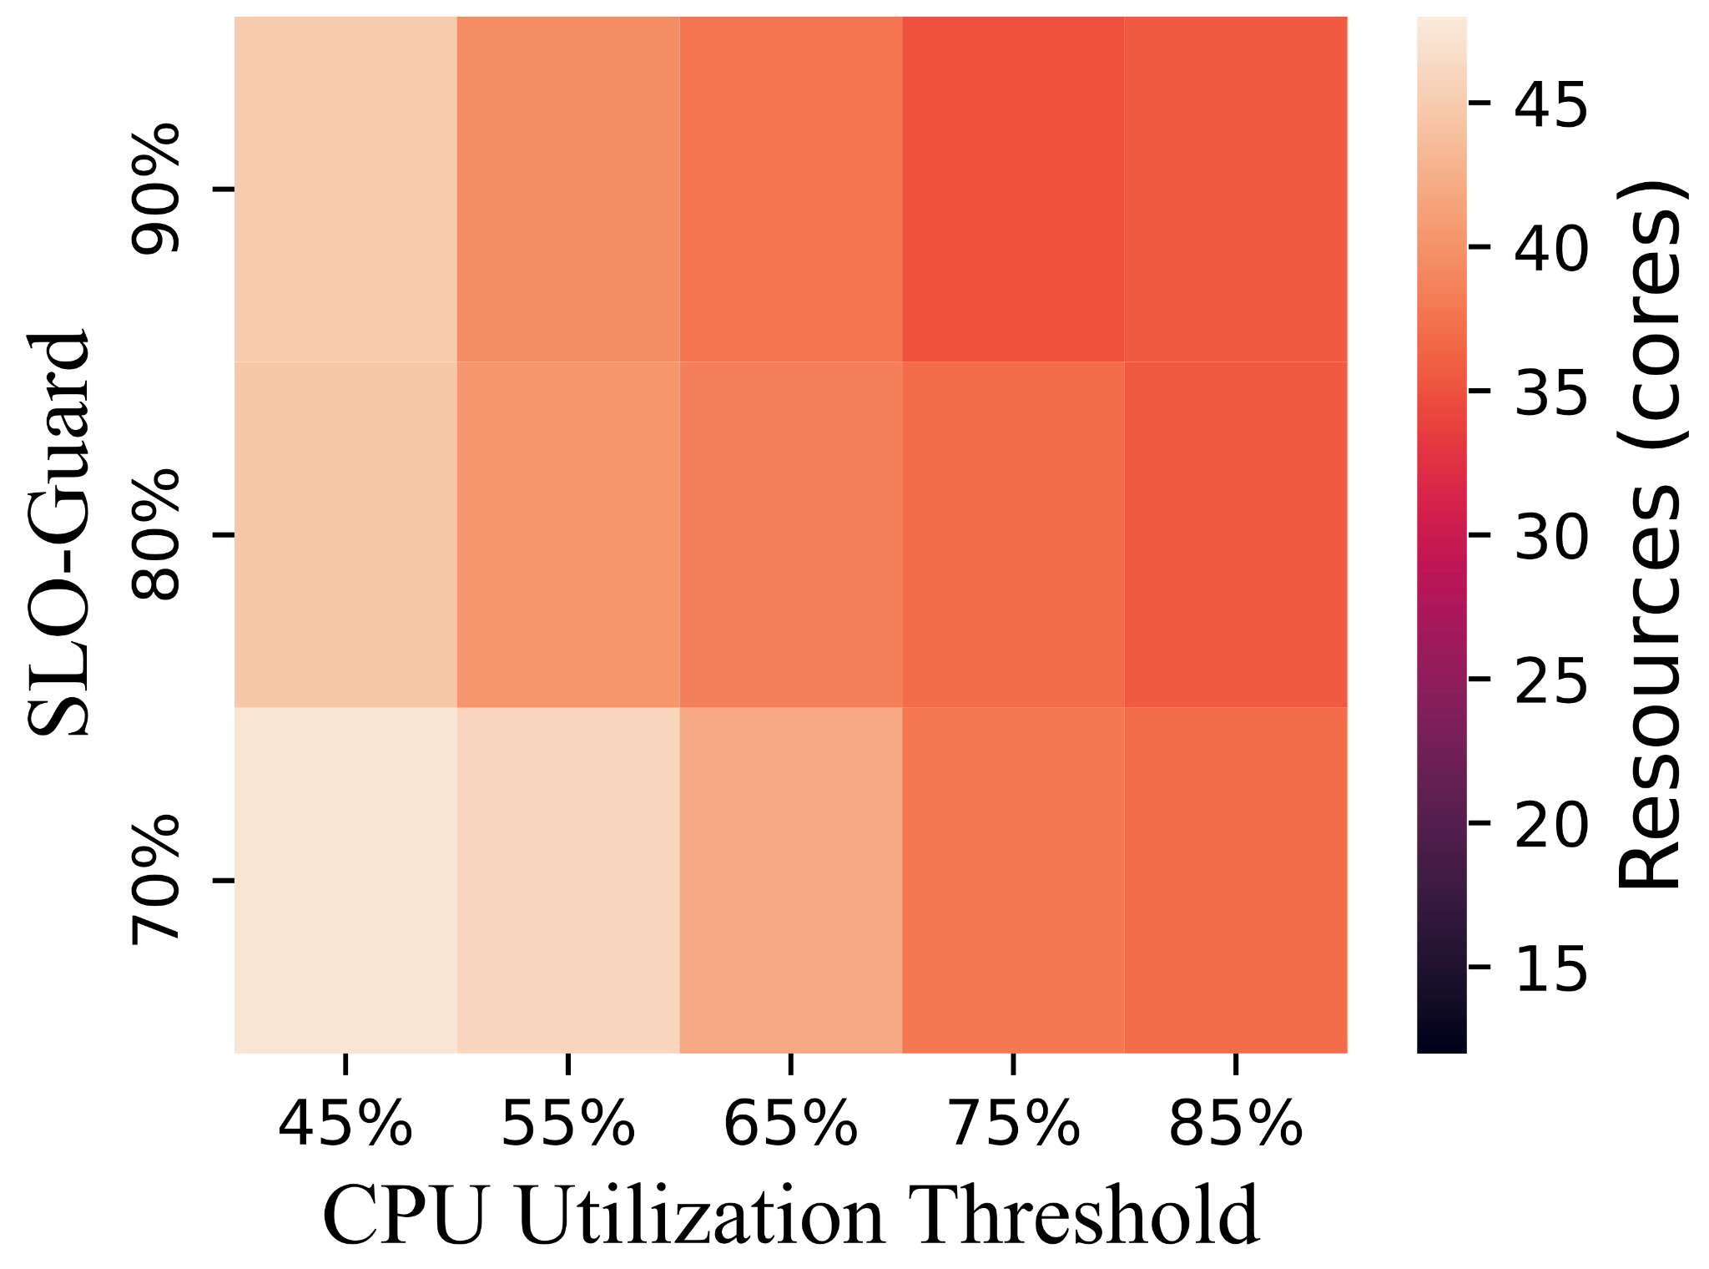
Evaluation (Sensitivity Analysis)
Key Takeaway: Indiscriminately allocating more resources may not necessarily enhance workload performance

Slide 20
A few References
[1] Kumar, Adithya, et al. "The fast and the frugal: Tail latency aware provisioning for coping with load variations." Proceedings of The Web Conference 2020. 2020.
[2] Al-Dulaimy, Auday, et al. "Multiscaler: A multi-loop auto-scaling approach for cloud-based applications." IEEE Transactions on Cloud Computing 10.4 (2020): 2769-2786.
[3] V. Rozite, E. Bertoli, and B. Reidenbach, “Data centres and data transmission networks,” IEA, 2023. [Online]
[4] Shaohong Li, Xi Wang, Xiao Zhang, Vasileios Kontorinis, Sreekumar Kodakara, David Lo, and Parthasarathy Ranganathan. 2020. Thunderbolt: throughput-optimized, quality-of-service-aware power capping at scale. In Proceedings of the 14th USENIX Conference on Operating Systems Design and Implementation (OSDI'20). USENIX Association, USA, Article 70, 1241–1255.

