Slide 1
Spark-based Cloud Data Analytics using Multi-Objective Optimization
  Fei Song, Khaled Zaouk, Chenghao Lyu, Arnab Sinha, Qi Fan, Yanlei Diao, Prashant Shenoy
Ecole Polytechnique, France
University of Massachusetts Amherst, USA
  School of Computer Science, Umass Amherst
Notes:
Title: Towards a Unified Data Analytics Optimizer
Abstract: Today's big data analytics systems are best effort only: despite the wide adoption, they still lack the ability to take user monetary constraints and performance goals, and automatically configure an analytic job to achieve those goals. Our work aims to take a step further towards building a new data analytics optimizer that works for arbitrary dataflow programs and determines the job configuration in an automated manner based on user objectives regarding latency, throughput, monetary cost, etc. At the core of the optimizer are a principled multi-objective optimization framework that enables one to explore the tradeoffs between different objectives, and a deep learning-based modeling approach that can learn a model for each user objective as complex as necessary for the user computing environment. Using both SQL-like and machine learning jobs in Spark, we show that our techniques can learn a model of each objective with high accuracy, and the multi-objective optimizer can automatically recommend new configurations that significantly improve performance from the configurations manually set by engineers.
Bio:
Yanlei Diao is Professor of Computer Science at Ecole Polytechnique and is also a tenured professor at the University of Massachusetts Amherst, USA. Her research interests lie in database systems and big data analytics. She received her PhD in Computer Science from the University of California, Berkeley. Prof. Diao was a recipient of the 2016 ERC Consolidator Award, 2013 CRA-W Borg Early Career Award (one female computer scientist selected each year for outstanding contributions), IBM Scalable Innovation Faculty Award, and NSF Career Award.

Slide 2




Use Case: Data Driven Analytics in the Cloud
SELECT C.uid, avg(P.pagerank)
FROM Clicks C, Pages P
WHERE C.url = P.url
GROUP BY C.uid
HAVING avg(P.pagerank) > 0.5
ORDER BY avg(P.pagerank)
Cloud Computing (EC2~190 instance types)
Cluster option: number of cores, memory size
Spark runtime parameters: number of executors, parallelism, etc.
Latency
Throughput
Cost
Sessionization
  Configuration:
  Cluster option
  Spark runtime parameters
Training of a classifier
Predication
Notes:
Numerous data-driven applications use could computing to support their data analytical needs.
Scalable big data analytics systems have gained widespread adoption.
However, our work is motivated by the observation of a fundamental limitation of today’s system.
[Despite the wide adoption, they still lack the ability to take user monetary constraints and performance goals, and automatically configure an analytic job to achieve those goals. ]
The user, Bob, runs a SQL job on click stream analysis.
The user, Alice, wants to train a classification model to predict buying intentions based on user behaviors on an e-commerce website.
Consider these users that aim to run [mixed SQL queries and machine learning] tasks using Spark Streaming in the Amazon EC2 cloud.
The user needs to first choose from ~60 Amazon EC2 instance types that differ in the number of cores and memory available.
-- [In particular, the number of cores determines the degree of parallelism that can be achieved in analytics. ]
The appropriate choice depends on the user workloads, performance goals, and budgetary constraints. It is often made as a guess by the user.

Slide 3
Data Analytics Optimizer
Broad Analytics
  SQL jobs, Machine Learning jobs, etc.
  Model: given a configuration, predict performance of user objectives when running a job
  Our optimizer can work with existing models such as Ottertune [SIGMOD, 2017] and Earnest [NSDI, 2016]
Multi-Objective Optimization
  Automatically select a configuration that can 'optimize' multiply objectives at the same time.
A running example
  X axis: latency objective
  Y axis: cost objective (number of cores)
  Each point: a trade off between latency and cost
Notes:
Due to the above reasons, numerous data analytics users and businesses are facing two major problems:
High operational cost: When our team interviewed several data analytics companies for their needs and constraints (to be detailed in Section 2), company A in the domain of data-driven security stated that as a medium-sized company, they had to spend 15 million dollars a year on cloud cost while
they wished to reduce the operation cost down to 3 million.
High human cost: To enable reduced cloud cost, the solution in industry today is to hire an engineer
team dedicated to the resource management issue for their data analytical needs. An alternative solution is to switch to cheaper cloud instances, i.e., spot instances, which are less reliable and can go away at any time. Therefore, engineers must keep a close eye on the availability and performance of spot instances for the analytical jobs being run, again leading to increased human cost. Given the large number of data analytics companies and data-driven applications today, such operational
and human costs are replicated across numerous companies and applications, resulting in waste of engineering effort for solving the same problem repeatedly and high overheads associated with data-driven insight discovery and decision making at large.

Slide 4
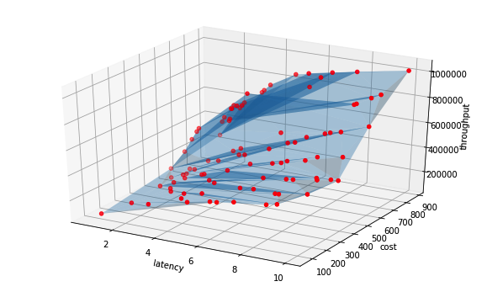



System Overview
User requests for scheduled workloads
Unified Data Analytics Optimizer (UDAO)
…
R4
R3
R2
R1
1. Multi-Objective
Optimization
2. Configuration Recommendation
Dataflow program
Objectives $\left\{F_{1},…, F_{k}\right\}$
Preferences (optional)
Pareto Frontier
Objective models
$${\{Ψ}_{1} , …, Ψ_{k}\}$$
Job configu-
ration
Provider’s requests for severless workloads
Runtime Engine
Runtime Engine
3. Model Server
HDFS
HDFS

Slide 5
Contributions
  A theoretical framework to transform a MOO problem to a set of constrained optimization (CO) problems
  Progressive Frontier (PF) algorithms: incremental, approximate, parallel
  Extensive experimentation, comparison, and analysis using TPCx_BB and streaming benchmarks.
Notes:
Despite wide adoption of big data analytics systems, today they still lack the ability to take user performance goals and budgetary constraints, collectively referred to as ``objectives'', and automatically configure an analytic job to achieve those objectives.
Our work aims to take a step further towards a unified data analytics optimizer that can determine the job configuration in an automated manner based on user objectives regarding latency, throughput, monetary cost, etc.
Towards this goal, we introduce two key concepts:
A principled multi-objective optimization framework that constructs a Pareto optimal set of job configurations to best explore the tradeoffs between different objectives.
The optimizer requires an accurate model of each objective for any given analytic program. Our work takes a new approach that learns a model for each user objective in the same computing environment as the job is being executed, i.e., in-situ modeling, and explores latest techniques in Deep Learning to develop models as complex as necessary for this environment.
Using both SQL and machine learning workloads in Spark, we show that (1) our techniques can learn a model of each objective with high accuracy, and (2) the multi-objective optimizer can indeed recommend new configurations automatically that lead to better performance or explore interesting tradeoffs.

Slide 6
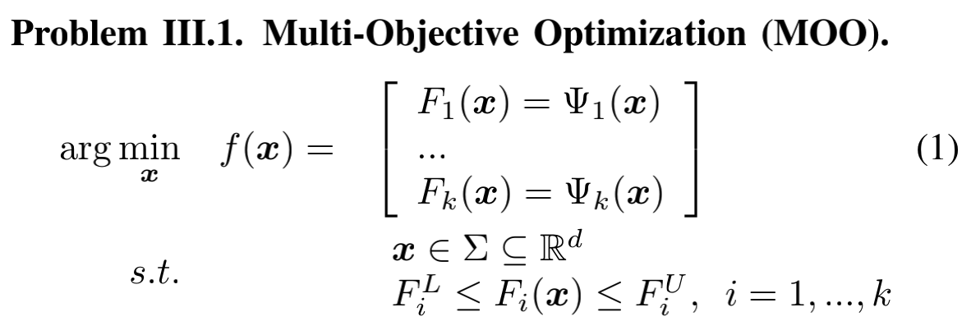
MOO: Problem Definition
  Pareto Optimality: a pareto point is not dominated by any other point in all objectives
  Pareto Set (Frontier): each point in the pareto set represents a specific trade off among different objectives
  x: configuration
  F₁(x): latency
  F₂(x): cost (number of cores)
  Ψ_{i}(x): model prediction
  F_{i}^{L}, F_{i}^{U}: constraints

Slide 7
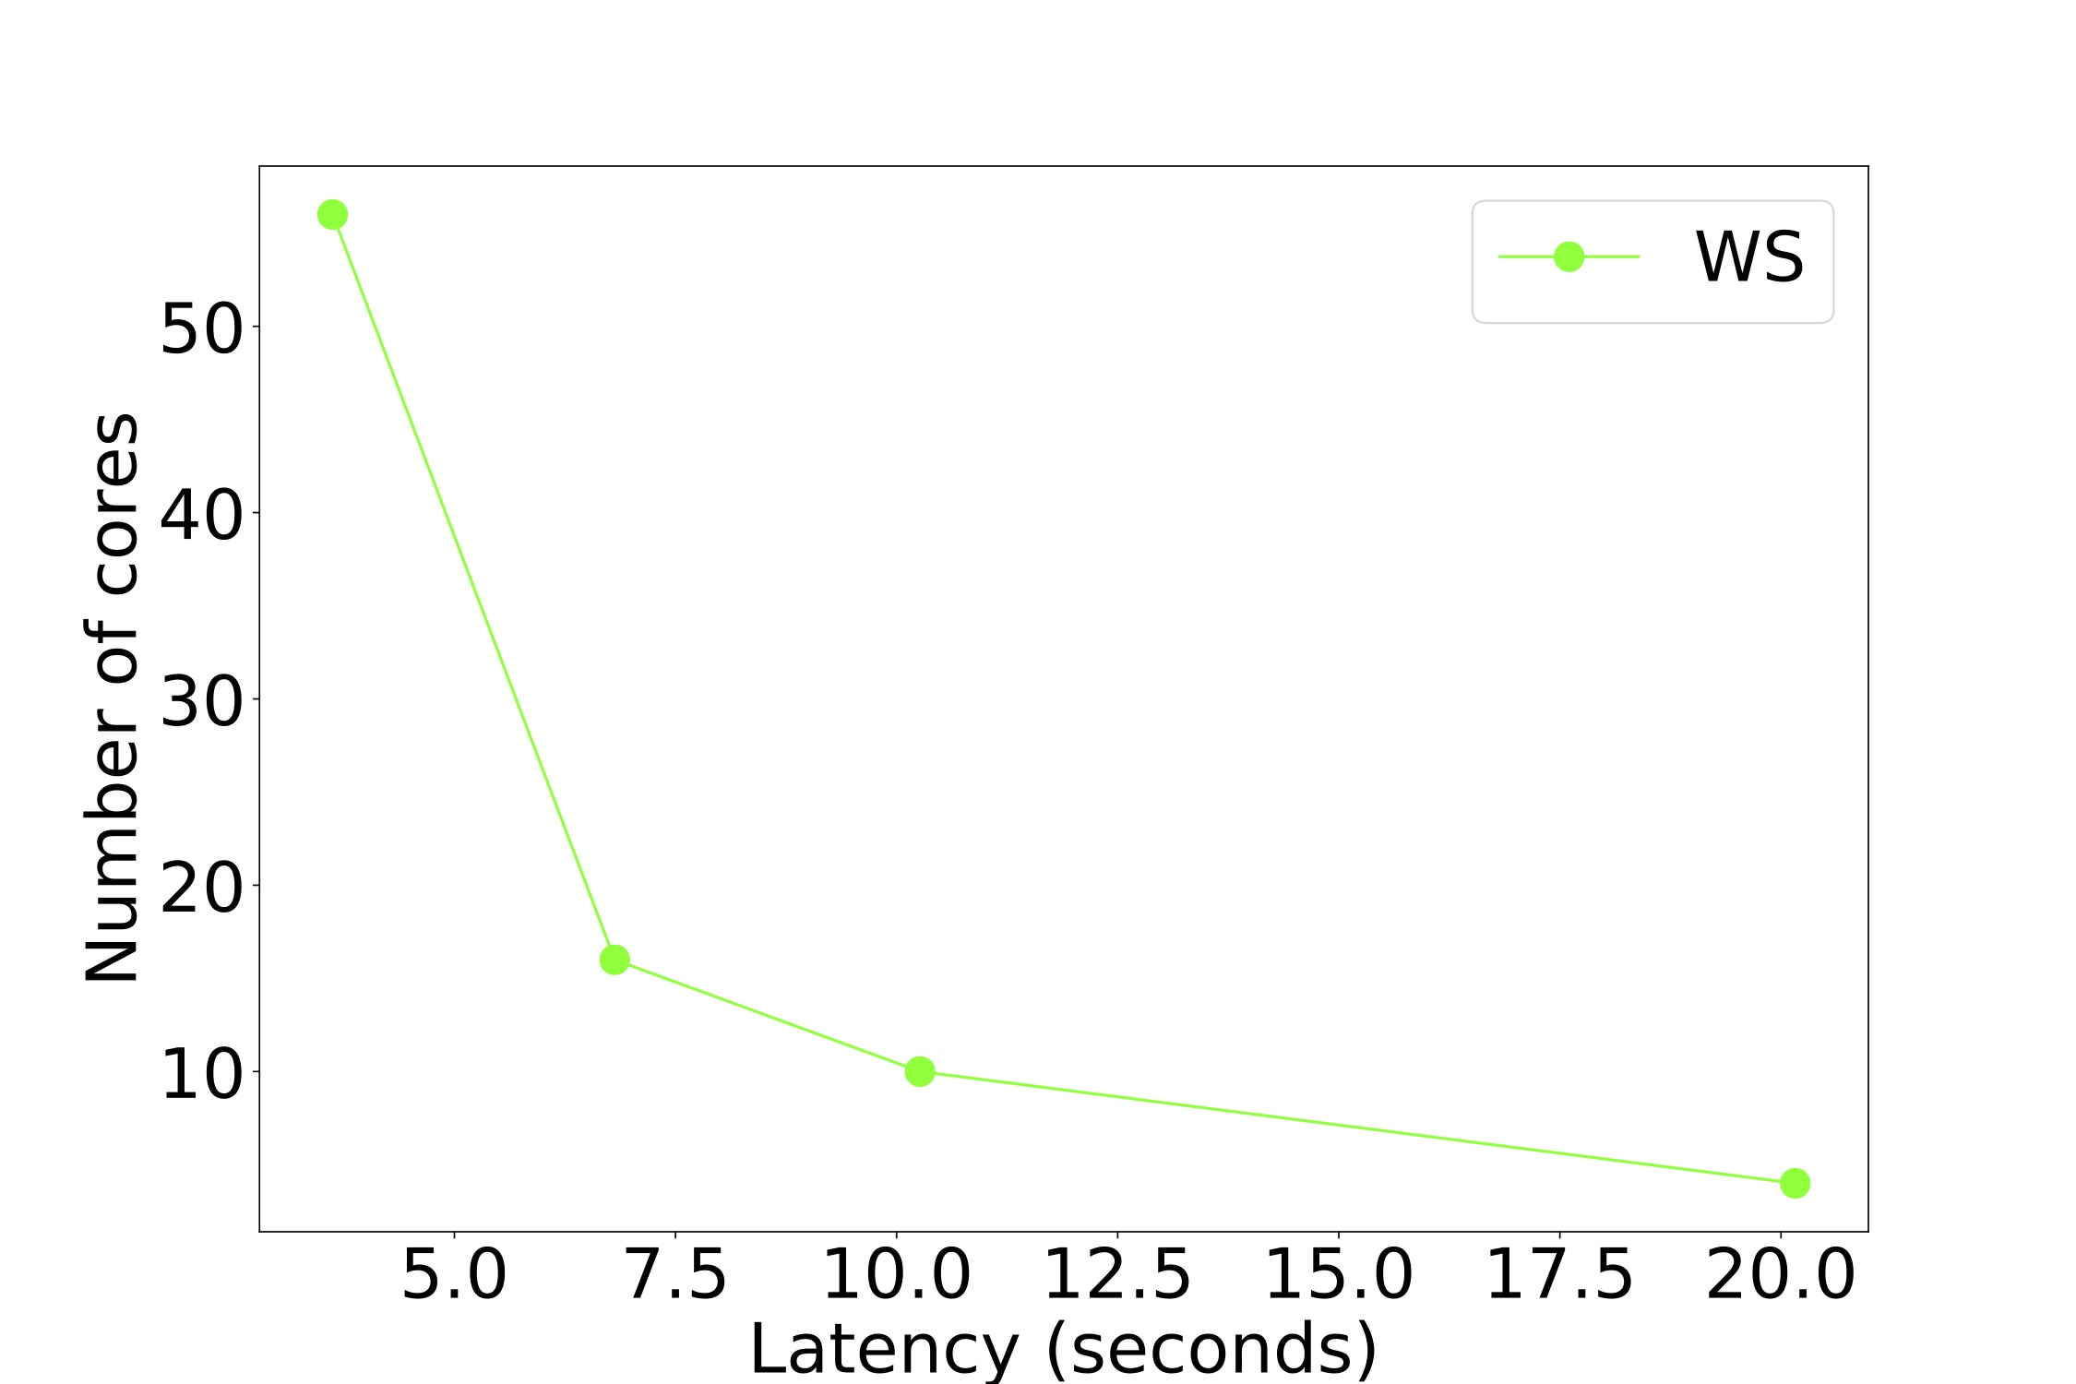
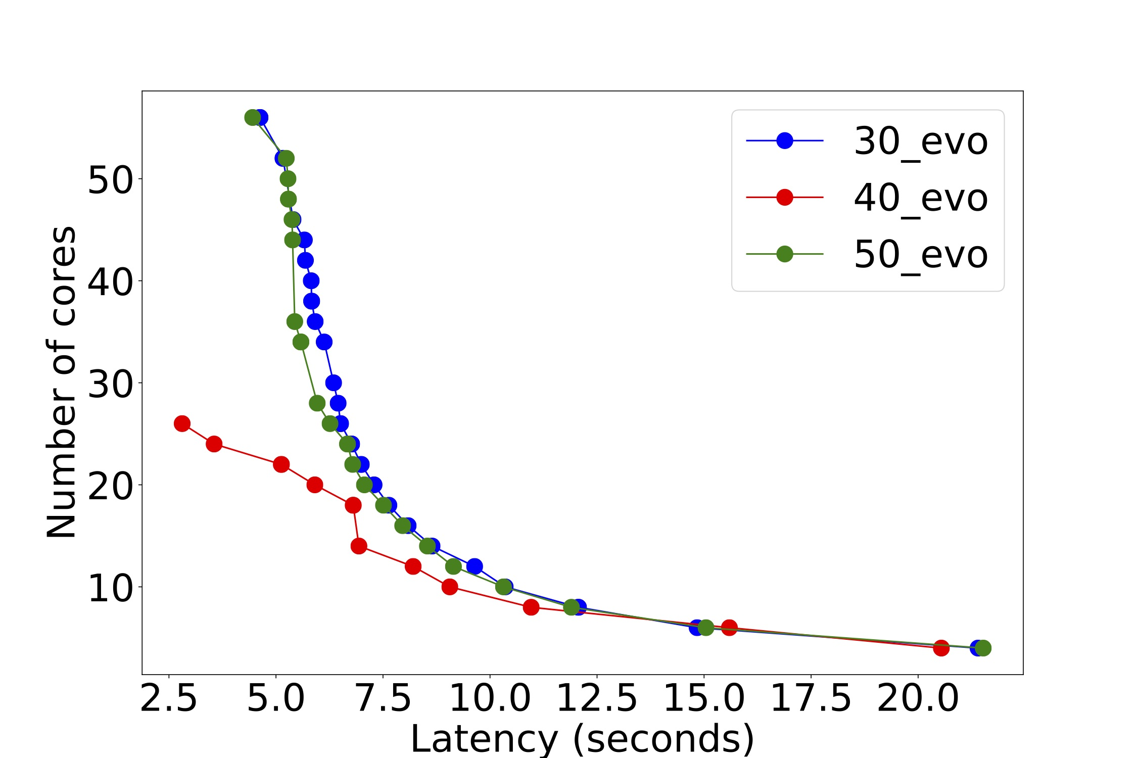
Challenges
New requirements targeting cloud environments
  High efficiency: within one to two seconds
  Good coverage: explore different trade offs
  Consistency: later recommendations do not contradict earlier ones
Weighted Sum: poor coverage
Evolutionary method: inconsistent
Notes:
Despite wide adoption of big data analytics systems, today they still lack the ability to take user performance goals and budgetary constraints, collectively referred to as ``objectives'', and automatically configure an analytic job to achieve those objectives.
Our work aims to take a step further towards a unified data analytics optimizer that can determine the job configuration in an automated manner based on user objectives regarding latency, throughput, monetary cost, etc.
Towards this goal, we introduce two key concepts:
A principled multi-objective optimization framework that constructs a Pareto optimal set of job configurations to best explore the tradeoffs between different objectives.
The optimizer requires an accurate model of each objective for any given analytic program. Our work takes a new approach that learns a model for each user objective in the same computing environment as the job is being executed, i.e., in-situ modeling, and explores latest techniques in Deep Learning to develop models as complex as necessary for this environment.
Using both SQL and machine learning workloads in Spark, we show that (1) our techniques can learn a model of each objective with high accuracy, and (2) the multi-objective optimizer can indeed recommend new configurations automatically that lead to better performance or explore interesting tradeoffs.

Slide 8
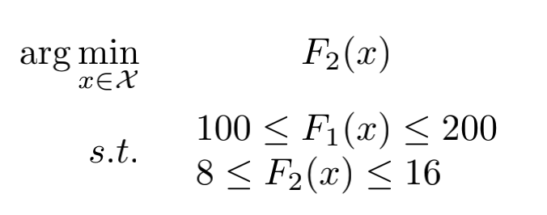
Progressive Frontier (PF) Approach
  Reference point: achieves OPT for a single objective
  Utopia/Nadir point: best/worst possible
  Uncertainty space: the volume of the rectangle
  Middle point probe: dividing the space, finding the rectangle with largest uncertainty space to explore
F2 (cost in #cores)
_{R}latency (100, 24)
(300, 24)_{𝒇}𝐍
_{𝒇}1 (150, 16)
_{𝒇}𝐔 (100, 8)
_{R}core (300, 8)
F1 (latency)

Slide 9
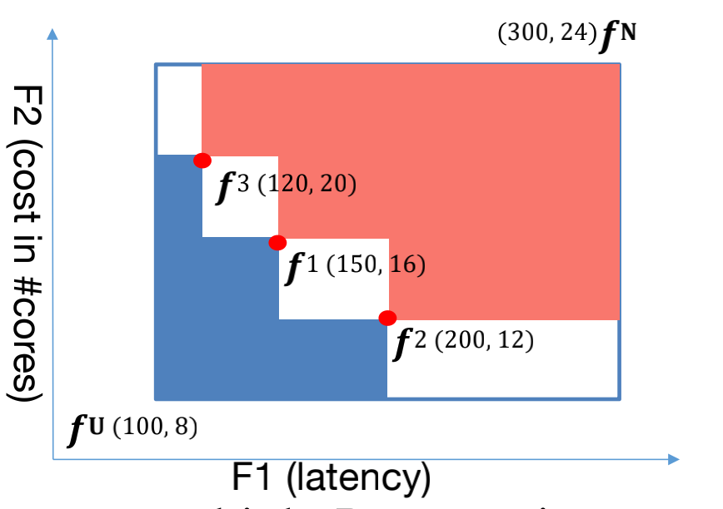
Progressive Frontier (PF) Approach
  Reference point: achieves OPT for a single objective
  Utopia/Nadir point: best/worst possible
  Uncertainty space: the volume of the rectangle
  Iterative middle point probe: recursively applies middle point probe
_{R}latency (100, 24)
(300, 24)_{𝒇}𝐍
F2 (cost in #cores)
_{𝒇}1 (150, 16)
_{𝒇}𝐔 (100, 8)
_{R}core (300, 8)
F1 (latency)

Slide 10
Formal Results
Theoretical conclusions of PF
  2D problems: guaranteed to find all the Pareto points if they are finite
  High-dimensional probems: guaranteed to find a subset of Pareto optimal points

Slide 11
Progressive Frontier (PF) Algorithms
PF-S (Sequential)
  Incremental
  Uncertainty-aware
PF-AS (Approximate)
  Solving CO’s approximately
  based on learned models
PF-AP (Parallel)
  Further adding parallel
  computing
Automatic selection
  Utopia Nearest (UN): distance to the Utopia
  Weighted Utopia Nearest (WUN): a weight vector to capture the importance among different objectives

Slide 12
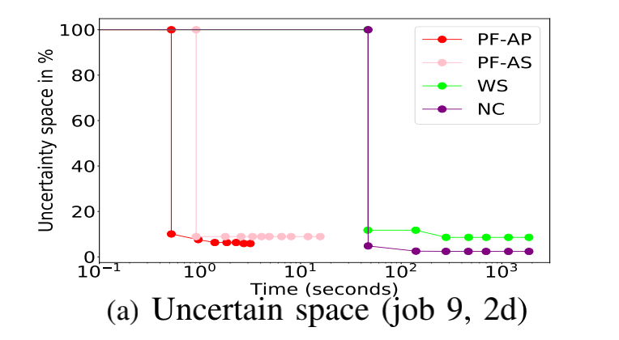
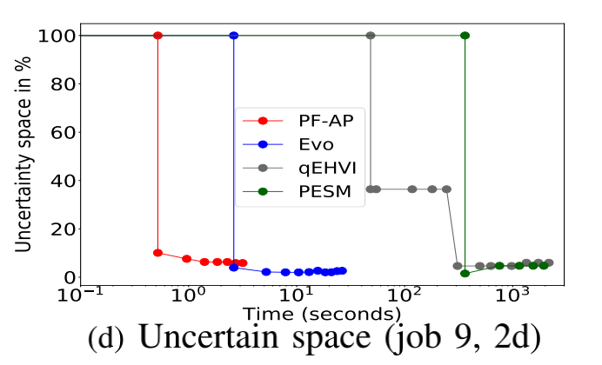
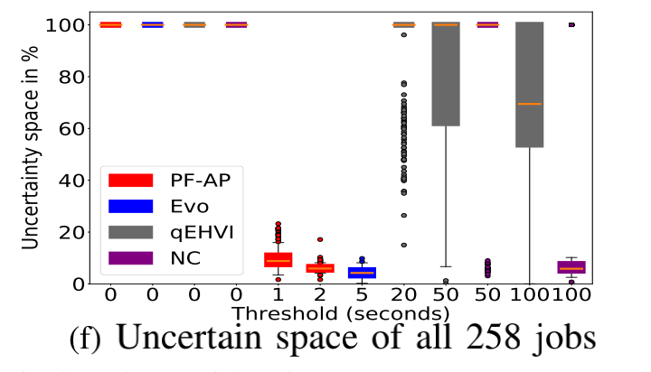
Experiment: MOO comparison
Summary PF-AP
  Batch 2d, 258 jobs, TPCx-BB benchmark
  Under 1 second, a median of 8.8% uncertain space,
  5.9% after 2 seconds
PF-AP: much faster, more consistent

Slide 13
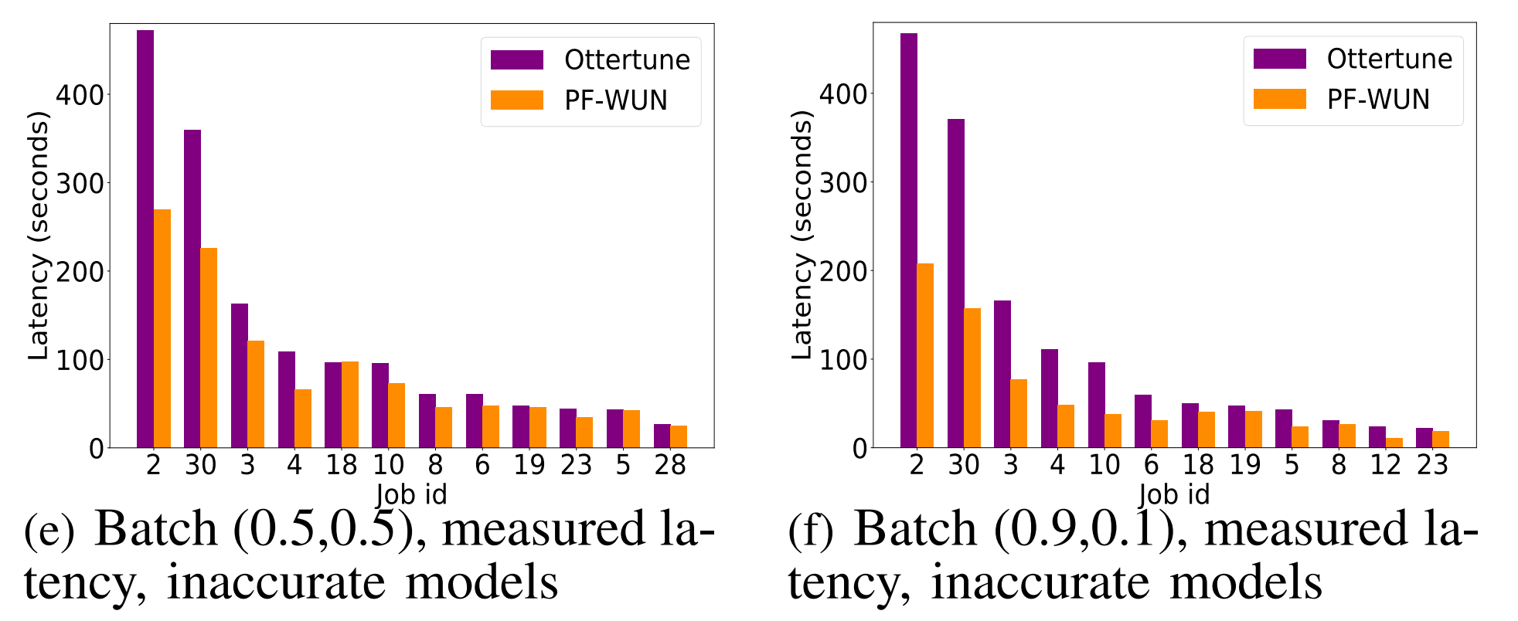
End to End Comparison to Ottertune
  (0.5, 0.5): PF-AP achieves 26% less running time and 3% less cost
  (0.9, 0.1): PF-AP achieves 49% less running time and 48% increase of cost. Strong preference on latency: Ottertune achieves only 6% reduction of total running time, while UDAO achieves 35%

Slide 14
Summary and Future Work
Summary
  UDAO, a multi-objective optimizer
  Outperforms existing MOO methods in both speed and coverage
  Outperforms Ottertune by a 26%-49% reduction in running time of the TPCx-BB benchmark
Future Work
  Extend UDAO to support a pipeline of analytic tasks
  Incorporate more complex and robust models

Slide 15
Thanks
Q&A

