Slide 1


Greening Electric Bike Sharing Using Solar Charging Stations
John Wamburu, Christopher Raff, David Irwin and Prashant Shenoy
University of Massachusetts, Amherst

Slide 2



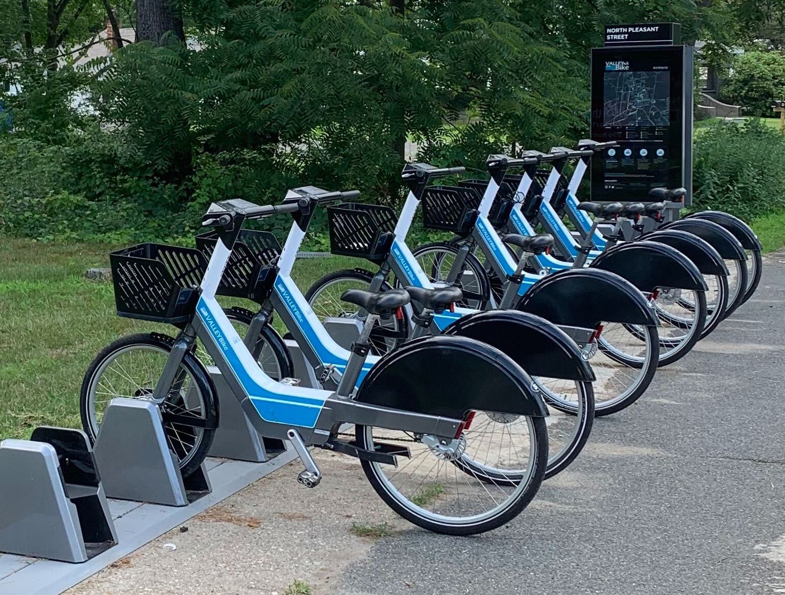
Rise of ride sharing
Catapulted by the ubiquity of smartphones
Mostly made up of car-based sharing and bike sharing
High carbon emissions

Slide 3
Research question
How can we make ride sharing greener?
Focus on electric bike sharing
  How can we make an electric bike sharing system zero carbon?

Slide 4
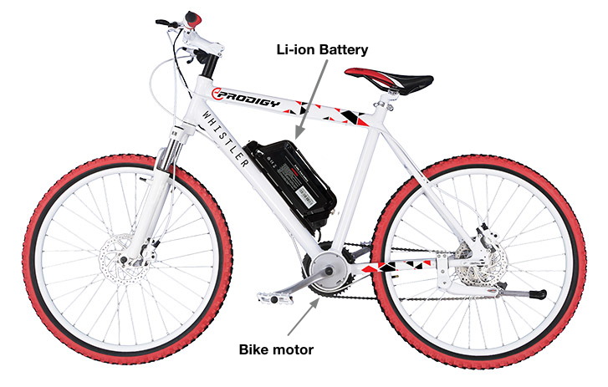
Electric bikes (E-bikes)
Type of small EV
Powered by electric grid
Requires electric charging infrastructure
Not zero-carbon
How can we make electric bike sharing zero carbon?

Slide 5
Outline
Introduction
Hardware design of a solar charging station
Analysis of an electric bike sharing system
Conclusions

Slide 6
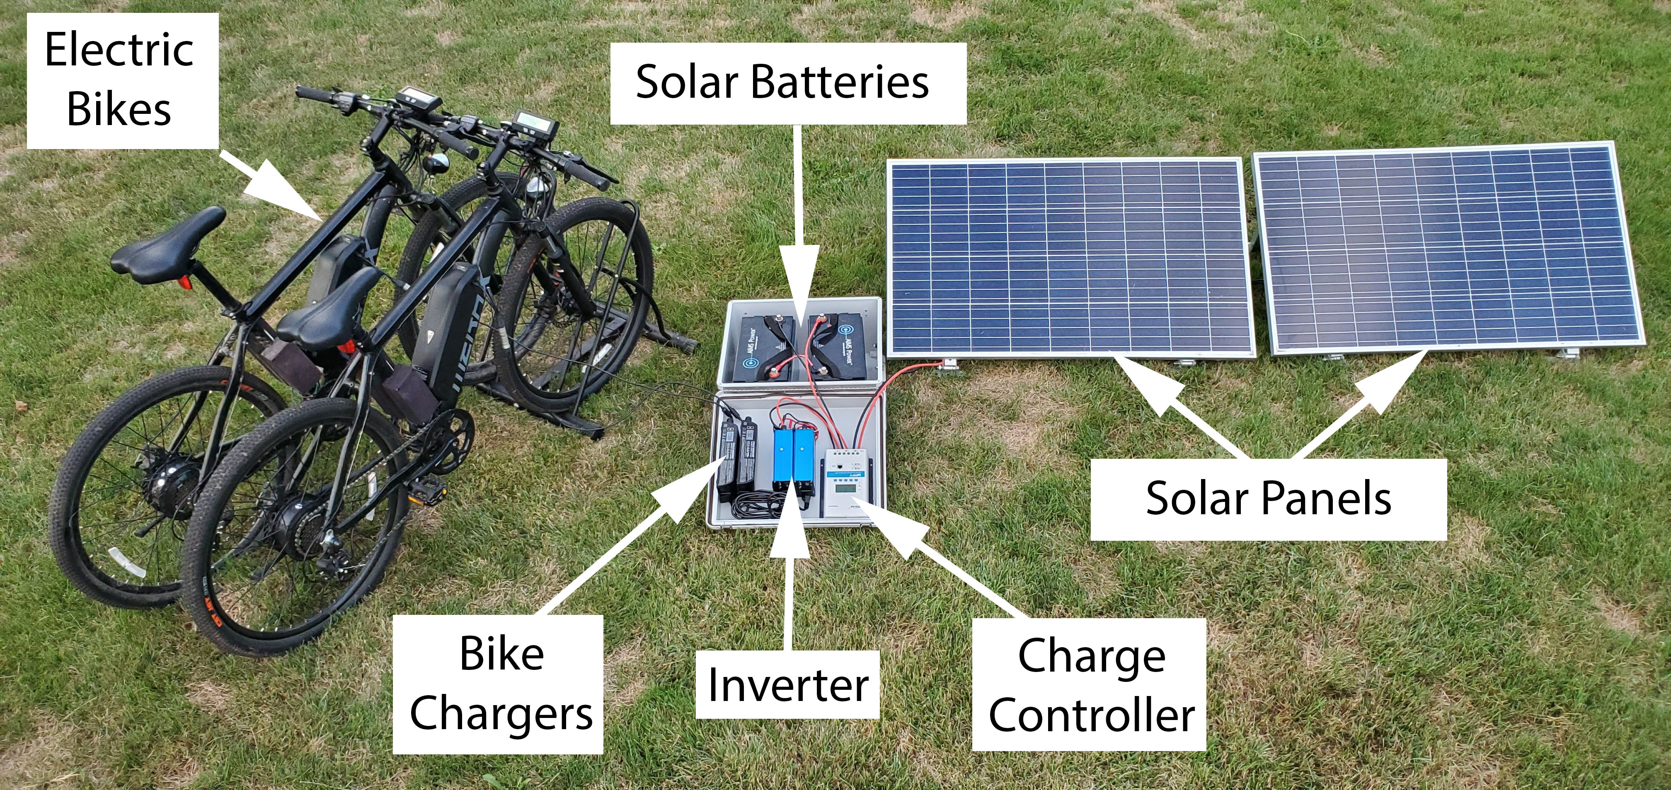
Prototype solar charging station design
Design Goals
Harvest enough solar energy to charge bikes docked at a station
Enough solar array to charge during the day
Have enough storage for backup energy during low solar hours e.g. night

Slide 7
Prototype data analysis
Able to generate 0.54kWh per day on single panel
Enough to charge 2 bikes to full capacity
Able to charge single bike battery from zero to full capacity in 3 hours

Slide 8
Designing an electric bike sharing system
How many solar panels and battery capacity are required in an entire bike sharing system?
  Grid-tied design
  Off-grid design

Slide 9
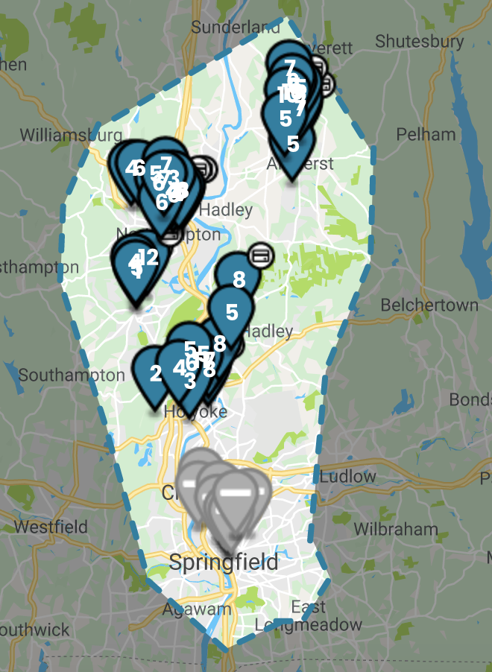




Analysis of an electric bike sharing system
59 Stations
490 Bikes
70,076 Trips
1 Year

Slide 10
Grid-tied net zero carbon design
Max annual energy consumption: 267kWh
Single 320W panel generation: 296kWh
Key result: A single panel installed at each station is capable of meeting entire annual energy demand.

Slide 11
Off-grid true zero carbon design
No. of panels required by season
Max no. of panels across seasons
Key result: an off-grid design requires approximately 2 panels per station in the average case, which is 2x higher than a net-metered design

Slide 12
Battery size and panel tradeoff
Battery size and panel array tradeoff
Battery size per station
Key result: there exists a tradeoff between the size of solar array installed and the required battery size per station

Slide 13
Carbon benefits
Total emission reduction in off-grid design: 0.2MT
Total emission reduction in net-metered design: 1.1MT
Key results
Carbon emission reduction is realized in both off-grid and grid-tied designs
Emission reduction in net-metered design much higher due to added benefit of injecting excess solar generation into the grid

Slide 14
Conclusions
We presented the design of a solar powered bike charging station
We showed the feasibility of the design in off-grid and net-metered designs
We showed that a single panel is sufficient to meet the annual energy demand of a station in the net-metered design
In the off-grid design, this is approximately 2x panels
Finally, we showed that up to 1.1MT of CO2 emission can be reduced annually by substituting grid energy with solar

Slide 15
Acknowledgements
Lab. for Advanced Software Systems: http://lass.cs.umass.edu
ValleyBike bike share system: https://www.valleybike.org/
NSF grant 1645952 and MA Department of Energy Resources.

Slide 16
Thanks!
John Wamburu
jwamburu@cs.umass.edu
University of Massachusetts Amherst

