Slide 1
Waiting Game: Optimally Provisioning Fixed Resources for Cloud-Enabled Schedulers
Pradeep Ambati, Noman Bashir, David Irwin, and Prashant Shenoy
University of Massachusetts Amherst
Supercomputing’20
November 18th 2020

Slide 2
Traditional Job Scheduling
Private clusters manage fixed resources
Provisioning for peak demand incurs a high capital cost
Results in low average utilization that wastes resources
Wasted Resources

Slide 3
Traditional Job Scheduling
Private clusters manage fixed resources
Often provision less than peak to increase average utilization and reduce cost
But, periodic job bursts, e.g., due to deadlines, can result in high waiting times
High Waiting Time
FEWER Wasted
Resources

Slide 4
Revisiting Job Scheduling
Decades of research on scheduling jobs for fixed resources
Many classic scheduling policies, e.g., FCFS, SJF, RR, priority, etc.
Performance well-studied both analytically and empirically
Cloud platforms offer a new approach
Lower costs by enabling 100% utilization
Pay for cloud resources only when jobs need them
Jobs never need to wait for resources
Clouds provide the illusion of infinite scalability
No Wasted Resources
No Waiting Time

Slide 5




Job Schedulers Now Cloud-Enabled
Most schedulers now support “auto-scaling”
Acquire cloud VMs when jobs submitted
Release cloud VMs when jobs finish
No longer a scheduling problem, since there is no resource constraint
Many Examples

Slide 6
Cloud Introduces New Price Dynamics
Two general types of resources
On-demand Resources – Acquire and release anytime, pay only when used
Fixed Resources – Commit to buying for a long period
Either reserved cloud resources, or on-premises servers
Key Point - fixed resources cheaper if highly utilized
Reserving m5.large VM from Amazon for 3 years costs $988
Renting m5.large VM on-demand for 3 years costs $2522
Fixed resources are 60% cheaper if 100% utilized

Slide 7
Optimizing Cost for Cloud-Enabled Schedulers
Requires hybrid cloud infrastructure
Fixed resources satisfy baseload at high utilization to lower cost
On-demand resources satisfy load bursts to lower waiting time

Slide 8
Introduce a Waiting Policy
Waiting policy is the dual of a scheduling policy
Scheduling policy → which jobs run when fixed resources are available
Waiting policy → which jobs wait when ﬁxed resources not available
Optimal provisioning dependent on waiting policy
No prior work defines or analyzes waiting policies
Dictates important non-intuitive tradeoff between waiting time and cost
Longer waiting times increase fixed resource utilization that lowers cost
But…when should jobs wait, and for how long?

Slide 9
Our Contributions
Introduce waiting policy concept
Define multiple fundamental waiting policies, e.g., AJW, NJW, SWW, LJW, etc.
Model and analyze waiting policies
Apply simple queuing models to understand tradeoffs
Implementation and Evaluation
Simulate waiting policies on real-world year-long trace with 14M jobs on 14k-core cluster

Slide 10
Understanding Marginal Analysis
Classic Marginal Analysis from Economics
Examine additional benefits of an activity compared to its costs
Optimizing mix of fixed and on-demand resources a classic marginal analysis problem
Example
Break Even Point 40%

Slide 11

Marginal Analysis under Waiting
Classic marginal analysis assumes jobs never wait
Jobs run immediately on a ﬁxed or on-demand resource
Straightforward to solve in standard queuing models using classic results by Erlang
No prior work on marginal analysis under waiting
Key point - cloud schedulers can explicitly control how long jobs wait

Slide 12
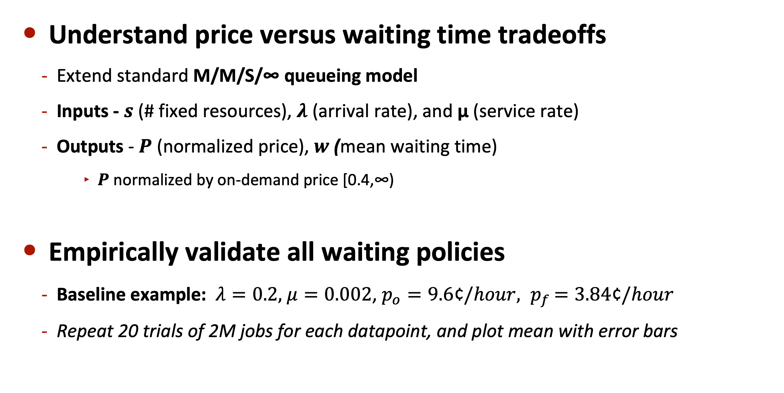
Analytically Modeling Waiting Policies
Understand price versus waiting time tradeoffs
Extend standard M/M/S/∞ queueing model
Inputs - $s$ (# fixed resources), $λ$ (arrival rate), and μ (service rate)
Outputs - $Ρ$ (normalized price), $w$ (mean waiting time)
$Ρ$ normalized by on-demand price [0.4,∞)
Empirically validate all waiting policies
Baseline example: $λ=0.2,$ $μ=0.002$, $p_{o}=9.6$¢$/hour{, p}_{f}=3.84$¢$/hour$
Repeat 20 trials of 2M jobs for each datapoint, and plot mean with error bars

Slide 13

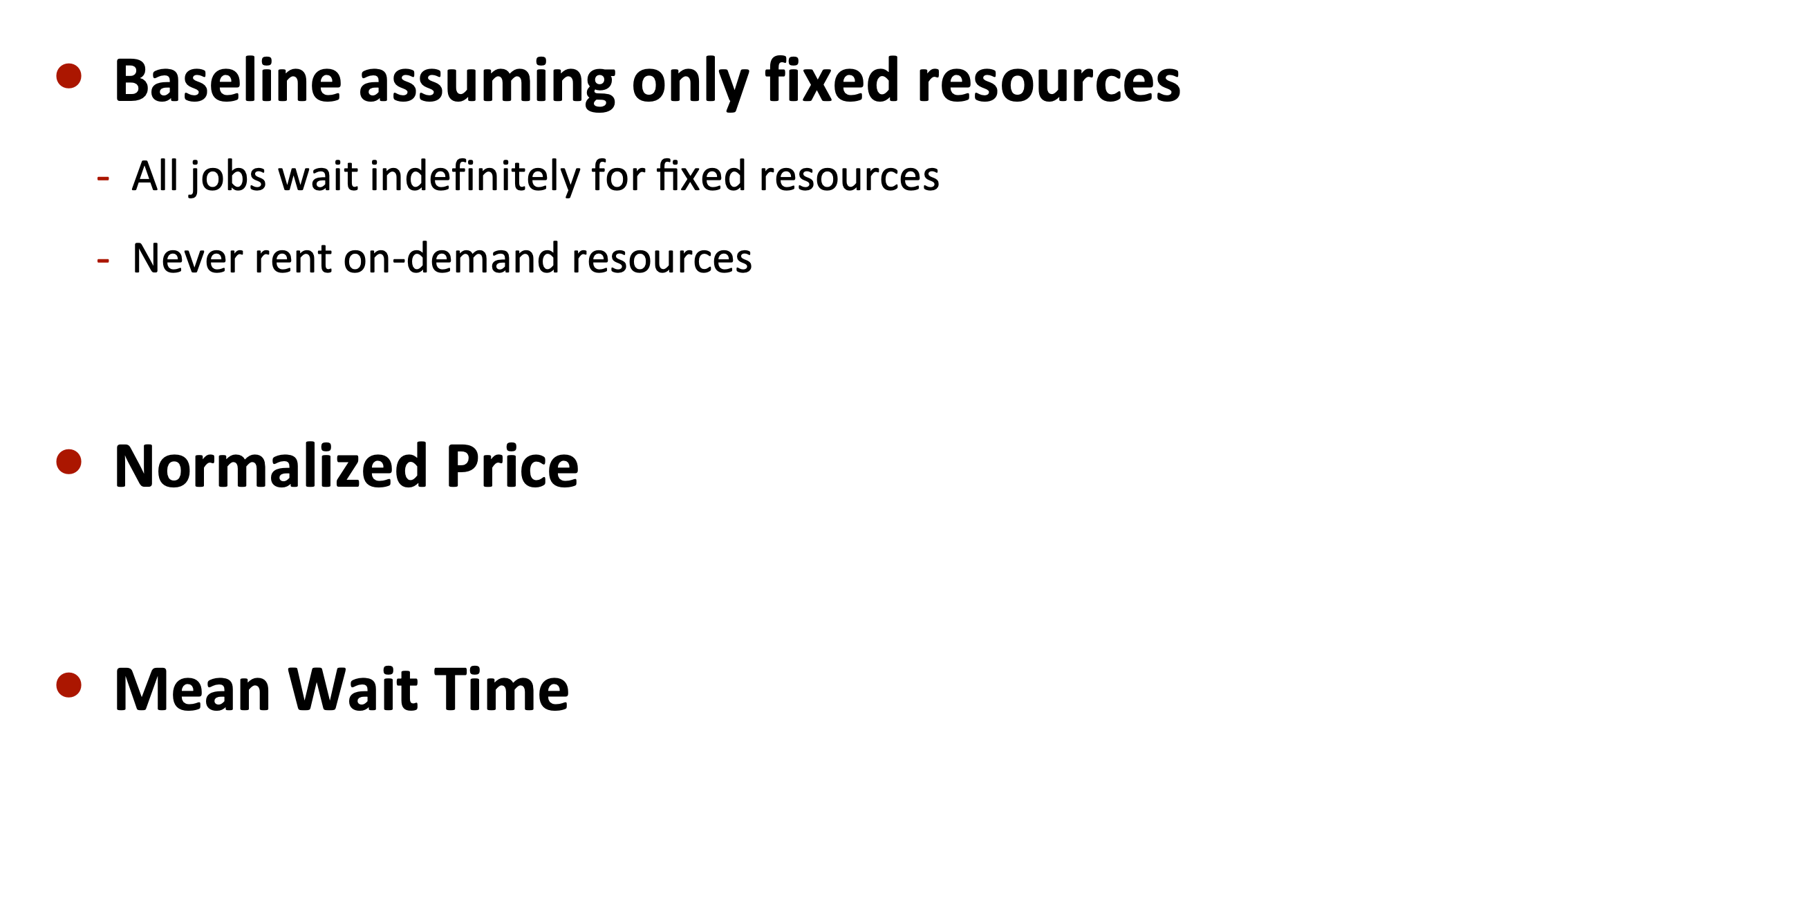
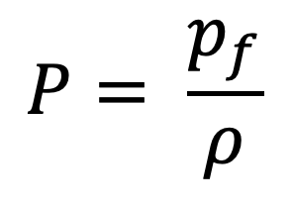
All Jobs Wait (AJW)
Baseline assuming only fixed resources
All jobs wait indefinitely for ﬁxed resources
Never rent on-demand resources
Normalized Price
Mean Wait Time
$$P= \frac{p_{f}}{ρ}$$

Slide 14
All Jobs Wait (AJW)
High Waiting Time
LOW Waiting Time
Key point – Encourages overprovisioning to ensure low waiting time

Slide 15
No Jobs Wait (NJW)
Akin to current auto-scaling policies
Run jobs on ﬁxed resources if available
Run jobs on on-demand resources if ﬁxed resources not available
Normalized Price
Mean Wait Time

Slide 16
No Jobs Wait (NJW)
Break Even Point
Key point – No price-waiting time tradeoff

Slide 17
All Jobs Waiting –Threshold (AJW-T)
Defines tradeoff between AJW and NJW
Run jobs on ﬁxed resources if available
Jobs wait up to threshold time 𝗯 if ﬁxed resources not available
At that waiting time, run on on-demand resources
Normalized Price
Mean Wait Time

Slide 18
All Jobs Waiting –Threshold (AJW-T)
NJW
AJW-T
AJW
Key point – Offers conﬁgurable price and waiting time tradeoff based on waiting time threshold b

Slide 19
Short Waits Wait (SWW)
SWW strictly better than AJW-T
Run jobs on ﬁxed resources if available
Jobs wait if waiting time would be less threshold b if fixed resources not available
Else, jobs immediately run on on-demand resources
Normalized Price
Mean Wait Time

Slide 20
Short Waits Wait (SWW)
AJW-T
SWW
Key point - Yields same price as AJW-T, but has a lower mean waiting time.

Slide 21
Long Jobs Wait (LJW)
Longer running jobs wait for ﬁxed resources
Like AJW, only for long jobs (runtime > threshold t)
Short jobs (runtime < threshold t) run immediately on on-demand resources
Normalized Price
Mean Wait Time

Slide 22
Long Jobs Wait
Key point – Offers good tradeoff, since price (blue) increase less steep than waiting time (red) decreases

Slide 23
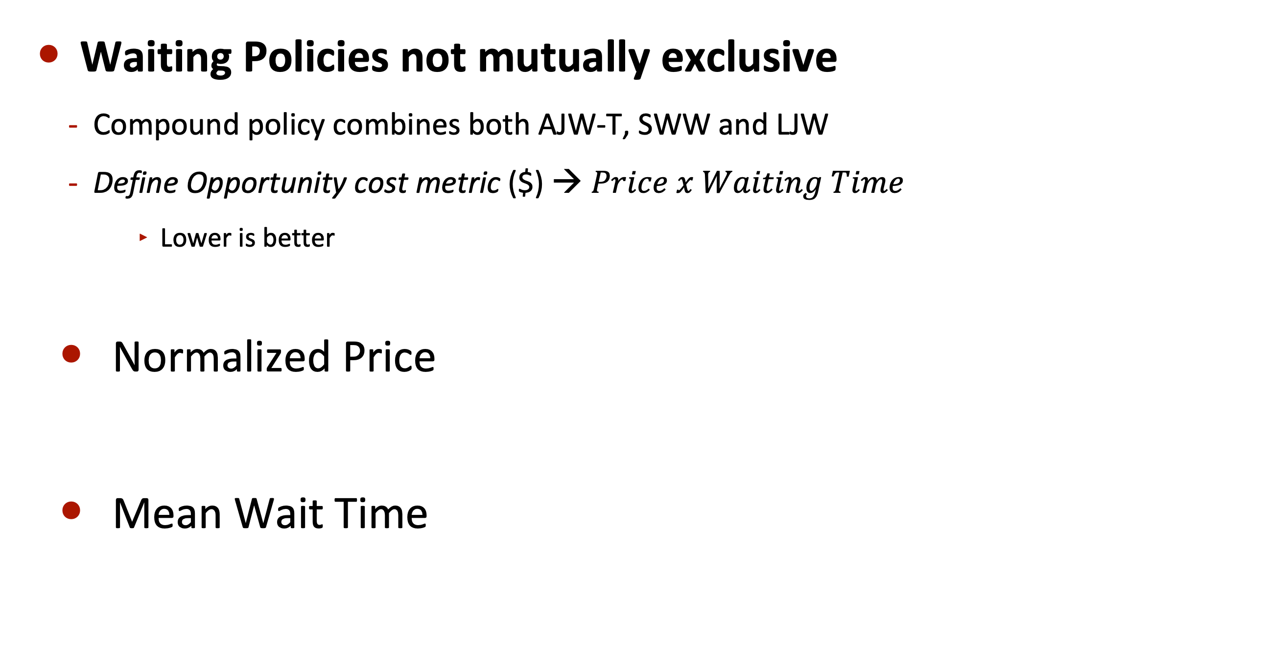
Compound Policy
Waiting Policies not mutually exclusive
Compound policy combines both AJW-T, SWW and LJW
Define Opportunity cost metric ($) → $Price x Waiting Time$
Lower is better
Normalized Price
Mean Wait Time

Slide 24
Compound Policy
SWW
AJW
LJW
Compound
Key point – Yields the best price-waiting time trade-off

Slide 25
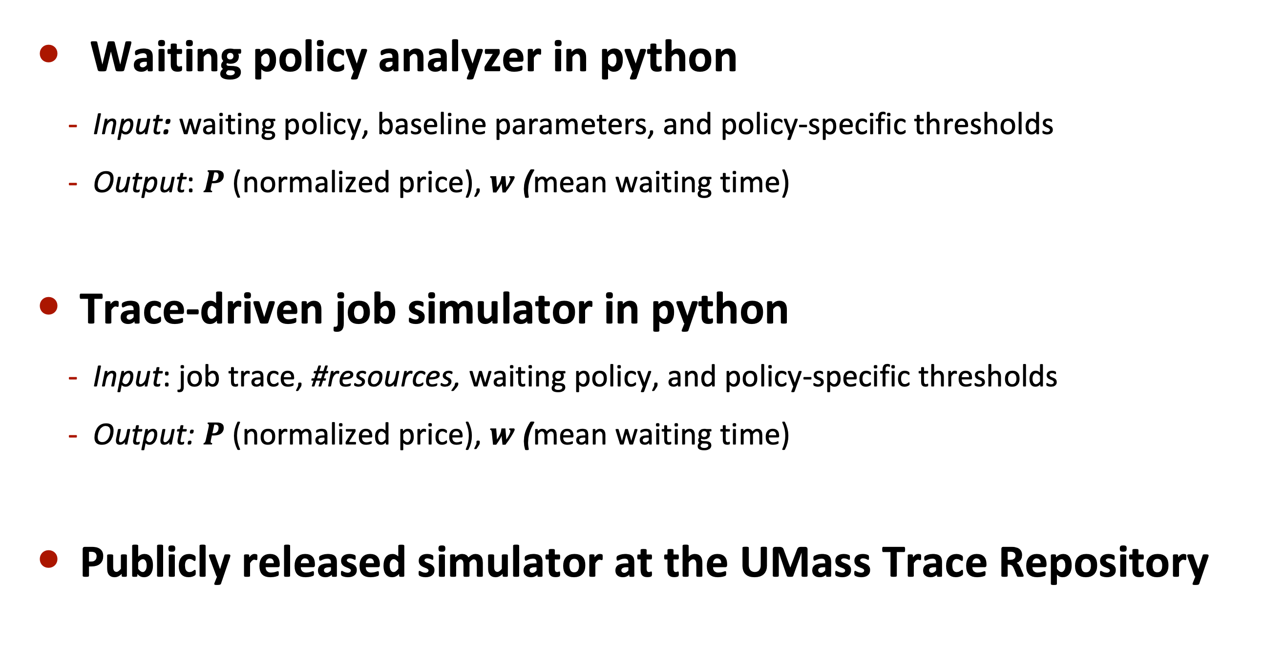
Implementation
Waiting policy analyzer in python
Input: waiting policy, baseline parameters, and policy-specific thresholds
Output: $Ρ$ (normalized price), $w$ (mean waiting time)
Trace-driven job simulator in python
Input: job trace, #resources, waiting policy, and policy-specific thresholds
Output: $Ρ$ (normalized price), $w$ (mean waiting time)
Publicly released simulator at the UMass Trace Repository

Slide 26

Evaluation
Use real-world workload for evaluation
Year long job trace with 14M jobs from a production HPC cluster
UMass system shared cluster consists 14.3k cores
Publicly released job trace at the UMass Trace Repository
Assume large m5.16xlarge (64 core) as fixed resource
Waiting threshold → 24 hours, Long job threshold → 3 minutes
Current cluster uses only fixed resources equivalent to 225 m5.16xlarge VMs

Slide 27
Evaluation – Normalized Price
OPTIMAL
Compound
CURRENT FIXED CLUSTER
Optimal compound policy (150 VMs) 5% cheaper than current fixed cluster (AJW, 225 VMs)

Slide 28
Evaluation – Waiting Time
Current fixed cluster
OPTIMAL
Compound
Optimal compound policy (150 VMs) yields 7x lower mean waiting time than current fixed size cluster (AJW, 225 VMs)

Slide 29
Conclusion
Key Contributions
Define multiple fundamental waiting policies, e.g., AJW, NJW, SWW, LJW, etc.
Apply simple queuing models to understand tradeoffs
Show benefits of waiting on real-world job trace
Promising New Research Area
Develop new and improved waiting policies
Implement in real job schedulers
Use ML to infer running times and waiting times
Apply to other domains such as transportation, energy etc.

Slide 30
Questions?

