Slide 1

Peak Forecasting for Battery-based Energy Optimizations in Campus Microgrids
Akhil Soman, Amee Trivedi, David Irwin, Beka Kosanovic,
Benjamin McDaniel, Prashant Shenoy
University of Massachusetts Amherst

Slide 2
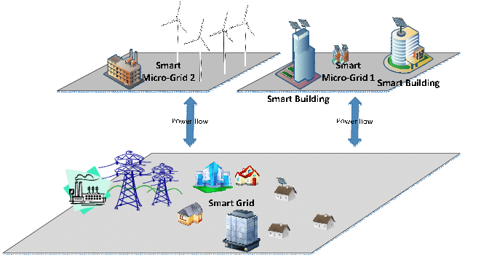
Motivation
Smart Grids are becoming commonplace in today’s world
Smart microgrids: local grid with control capability and autonomous operation
Energy optimizations: Peak shaving, demand charge reduction, load flattening
Common characteristic: knowledge of when peak occurs
Peak forecasting problem: Predict the future peak load
Figure courtesy: N. Naji

Slide 3
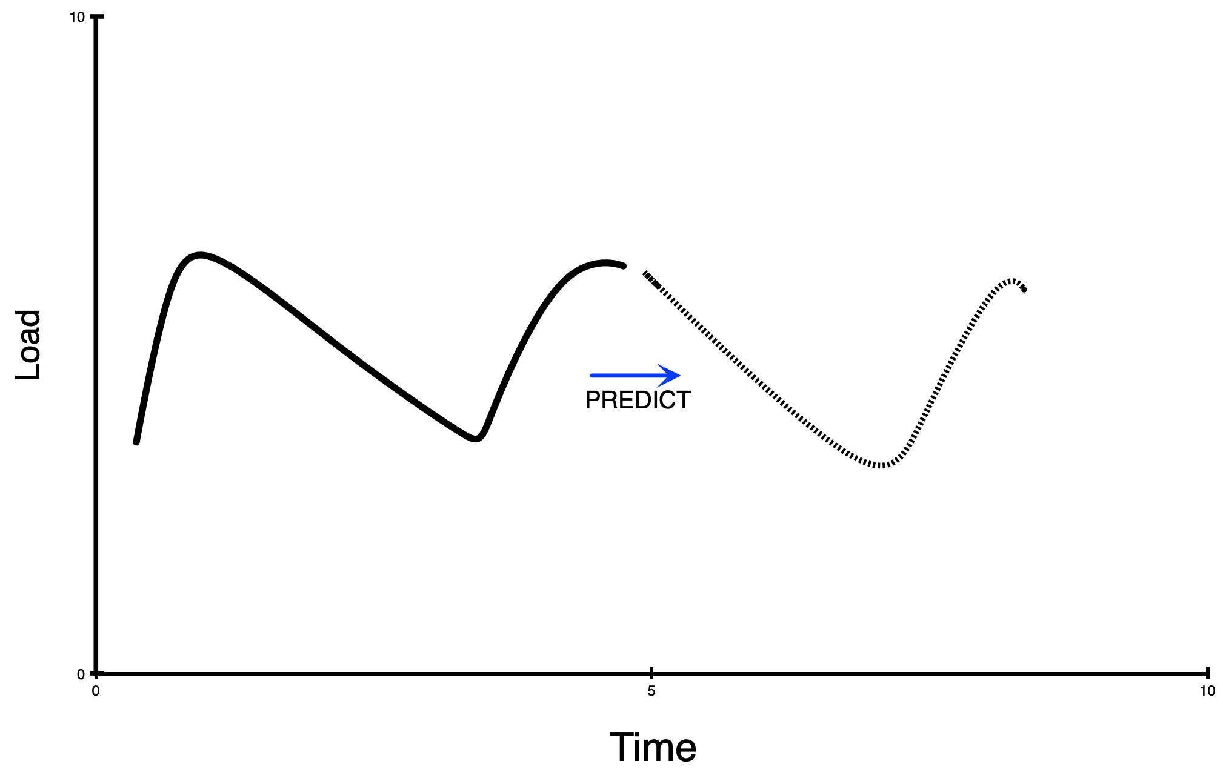
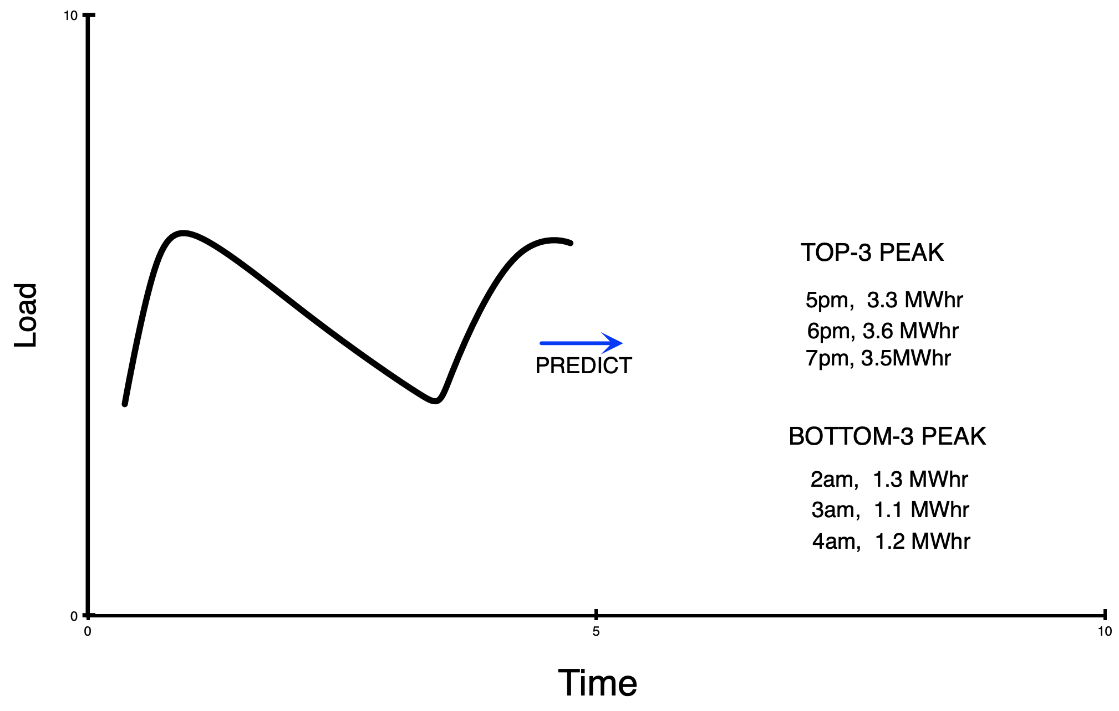
Load Forecasting vs Peak Forecasting
Load Forecasting : Predict future demand over forecasting horizon
Well studied problem
[Son et. al] [Ghasemi et al]
Load forecasting can identify peaks, but less effective.
Peak Forecasting : Identify when future peak occurs and its magnitude
Less studied [Jiang et. al.]

Slide 4
Talk Outline
Motivation
Peak Forecasting using Machine Learning
Evaluation and Case study
Results

Slide 5
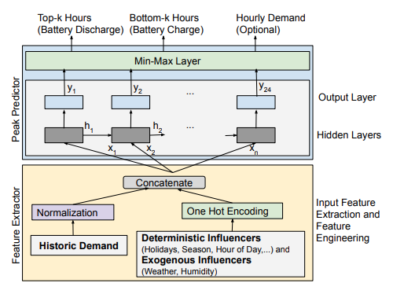
LSTM-based Peak Prediction
Objective : Predict top ‘k’ and bottom ‘k’ hours
LSTM based machine learning approach
Features: historic demand, season, semester, time of the day, local weather
Peak Predictor: 4-layer LSTM

Slide 6
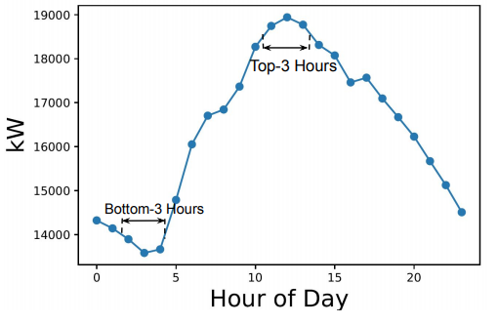
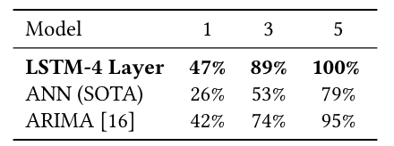
Model Accuracy
Dataset : Campus microgrid of 156 buildings with 2 year trace.
Top k hour peak prediction accuracy
Example Peak Forecast

Slide 7
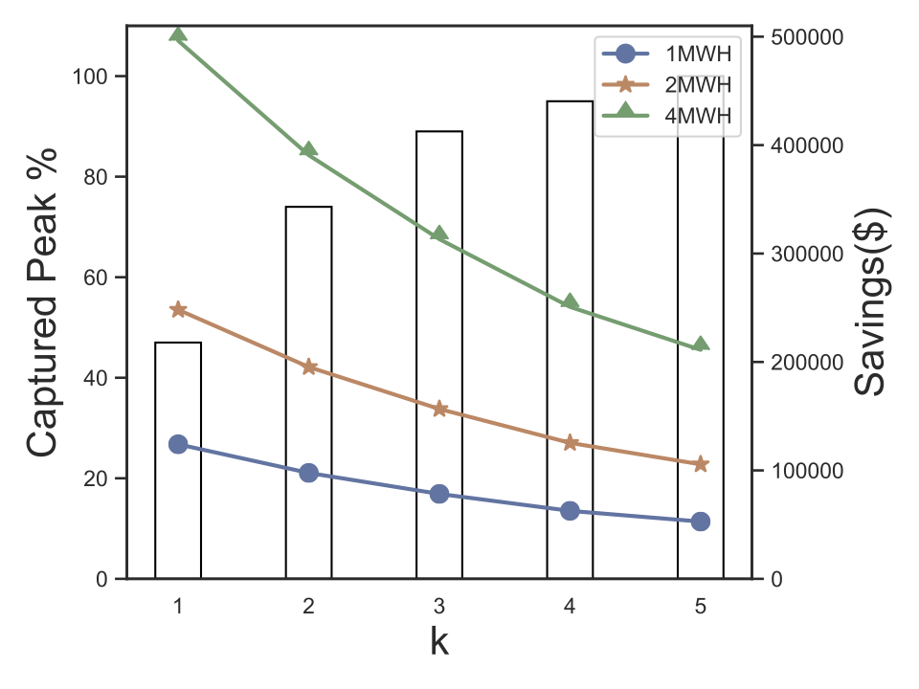
Battery Case Study
UMass Campus Microgrid: Onsite powerplant, Solar arrays and 4 MWhr Battery + local electric grid.
Cost of electric demand - $22/kW
LSTM model used to predict top-k and bottom-k hours, k<5
Battery charged during bottom-k hours and discharged during top-k hours
Annual savings of $496,320!

Slide 8
Implementation
Prototype implementation in python
Code release : https://github.com/umassos/peak-prediction
Low footprint and efficient
4-layer model : 300 kB RAM
2-layer model : 150 kB RAM
1.8 second CPU time for day ahead forecast on Raspberry pi.

Slide 9
Conclusions
Peak forecasting is related to but distinct from load forecasting
LSTM-based machine learning approach
Outperforms state-of-the-art forecasting methods
Useful for battery-based grid optimization

Slide 10
Thank you
Questions?

